Slide 1
GCSE Sociology
Education (Paper 1)
Key Information

Slide 2
Topic Content
Education Policy
Types of Schools
State and Private Schools
The Tripartite System
The Comprehensive System
The Education Reform Act
Marketisation and Parentocracy
New Labour Policies
Inequality in Education
Subcultures and Labelling
Setting, Streaming and Mixed Ability
Inequality and Gender
Inequality and Class
Inequality and Ethnicity
Perspectives
The Hidden Curriculum
Functionalist
Marxist

Slide 3
Education Social Policy

Slide 4
Types of School
Type of School | Definition
Specialist Schools | State schools which specialise in a certain area of the curriculum. They were set up in the 1990s to build on the strengths of schools, intending to raise levels of achievement.
Academy | Academies are state-funded schools that are funded directly by the government rather than by the local education authority.
Faith School | Have to follow the national curriculum, but can choose what they teach in RE. May have different admissions criteria and staffing policies to state schools.
Free School | Funded by the government but are not run by the local authority. They have more control over how they do things, e.g. curriculum and staff pay and conditions.
Special Educational Needs School | Schools for children with additional needs, these could be social, emotional, physical or intellectual.
Pupil Referral Unit | An alternative education provision which is for children who aren’t able to attend mainstream school.
Homeschooling | Educating your own children instead of sending them to school.
Deschooling | An educational method that promotes the freedom of children to choose what they want to learn. An alternative to formal schooling.

Slide 5
State and Private Schools
State Schools
A state school is a school which is funded by the government.
Private Schools
A private school is a school which is paid for by parents, also known as an independent or public school.
Arguments For Private Schools | Arguments Against Private Schools
Smaller class sizes Better facilities (e.g. IT and sports facilities) Higher chance of going to university Improves an individual’s life chances Meet people in high places | Gives some (middle/upper class) students an unfair advantage Taxpayers fund trainee teachers who then go on to work in private schools (teaching only a small minority of students) ‘Old Boys Network’- those in high positions tend to hire people of a similar background.
Only about 6% of all children attend private schools but:
74% of judges are privately educated
29% of MPs are privately educated
44% of newspaper columnists are privately educated.

Slide 6
The Butler Act (1945)
The Butler Act brought in compulsory, free education for all pupils in the UK aged between 5 and 15. It was brought in by the Conservative government, and consisted of four education providers:
Primary (5-11)
Secondary (11-15)
Further (5-18)
Higher (18+)
The Act also brought in 3 different types of secondary schools, this was known as the Tripartite System. Every child would take the 11+ exam to determine which school they would attend.
Grammar (15-20%) for academic children who were expected to go on to A Levels and University.
Technical (10-20%) for pupils who were more practical and not academically able to get into the Grammar schools.
Secondary Modern (60-70%) for pupils that didn’t fit the other two schools.
Problems with the Tripartite System
The 11+ is unfair. Assumes the child was educated in the UK Assumes English as a first language. Tests knowledge rather than skills. Class Divisions Reinforced class divisions- middle class more likely to go to grammar schools and working class more likely to go to secondary moderns Self Fulfilling Prophecy Students labelled as low ability are more likely to accept this and their talent and skill was wasted

Slide 7
Comprehensivisation (1964)
The government wanted to bring in a system that meant all pupils had access to the same education under the same roof.The Labour government, after 1964, encouraged the development of these schools and through the 1970s they took the place of grammar schools and secondary modern schools in most areas of the country.
Functionalists argue that comprehensive schools promote social integration by bringing children of different social classes together. However, other sociologists argue that there is little social mixing between working class and middle class students, largely because of setting and streaming.
However, Marxists argue that comprehensives are not meritocratic. They reproduce class inequalities through the continuation of streaming and labelling.

Slide 8
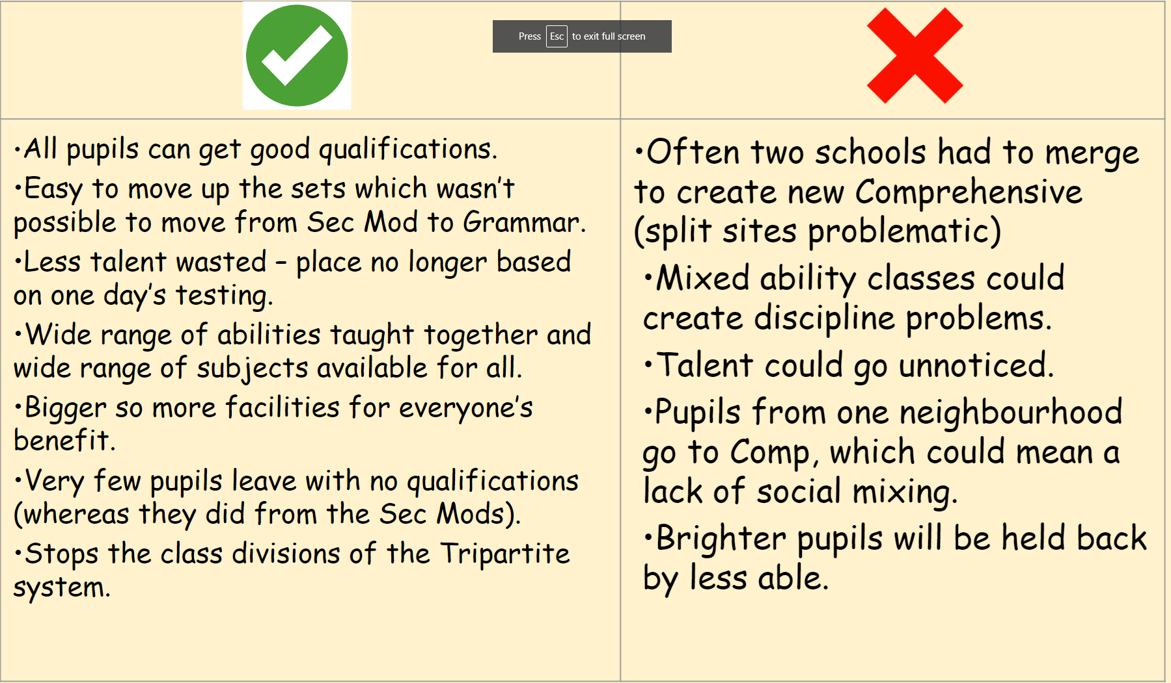
Comprehensivisation (1964)

Slide 9
Marketisation
Marketisation is the process of introducing competition and choice into the education system. Some sociologists argue that marketisation means that schools have to attract customers (parents) by competing with each other in the market. Schools that provide customers with what they want- such as exam success- will thrive, and those that don’t will ‘go out of business’.
Publication of Ofsted inspections and league tables that rank each school according to its eam performance give parents the information they need to choose the right school.
Wider range of schools
Open enrolment means that successful schools can recruit more students outside of their catchment area.
League Tables
However, Ball argues that marketisation policies such as league tables and formula funding reproduce class inequalities.
The policy of publishing school’s exam results ensures that schools that achieve good grades are more in demand, because parents are attracted to those with good league table rankings. This encourages:
Cream-skimming: ‘good’ schools can be more selective, choosing their own customers and recruit high achieving, mainly middle-class pupils. As a result these pupils gain an advantage.
Silt-shifting: ;good’ schools can avoid taking less able pupils who are likely to get poorer results and damage the school’s position in the league tables.
For schools with poor league table positions, the opposite applies; they cannot afford to be selective and have to take less able, mainly working-class pupils, so their results are poorer and they remain unattractive to middle-class parents.
The overall effect of league tables is thus to produce unequal schools that reproduce social class inequalities.

Slide 10
Marketisation
National Curriculum
All children have access to the same quality of education no matter where they live in the country
League Tables
Designed to give parents more choice and raise standards through competition.
SAT’s
Testing – 11 and 16 (used to be 7 and 14 but changed under Labour)
National targets are set in order to monitor if the system is working (raise standards by identifying problems = intervention)
Parents have more choice because they can compare the results of different schools.
Formula Funding
Schools and colleges are funded by a formula which is based on the number of students they attract. The aim of this initiative is to drive up standards by rewarding successful schools (competition)
Open enrolment
Parents are allowed to express a preference for the school of their choice. The idea behind this is that schools would have to compete with each other to attract pupils thus raising standards
Ofsted
To ensure that schools, colleges and local education authorities were doing a good job by publishing their reports and requesting action to be taken
Vocational Education
Aimed at meeting the needs of industry by ensuring that students leave school with the skills and qualities needed for working life. This included BTEC’s, apprenticeships, NVQ’s etc

Slide 11

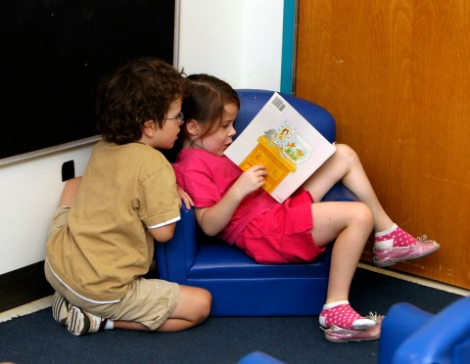
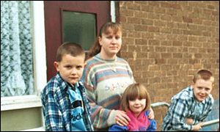
Marketisation
Formula Funding
Schools are allocated funds by a formula based on how many pupils they attract. As a result, popular schools get more funds and so can afford better-qualified teachers and better facilities. Again, their popularity allows them to be more selective and attracts more able or ambitious, generally middle-class, applicants.
On the other hand, unpopular schools lose income and find it difficult to match the teacher skills and facilities of their more successful rivals. Thus, popular schools with good results thrive; unpopular schools fail to attract pupils and their funding is further reduced.
Privileged Skilled Choosers are mainly middle class parents who use their economic and cultural capital to choose schools for their children.
They use league tables and Ofsted reports and know how the education system works, giving their children an advantage.
Semi Skilled Choosers are parents who are mainly working class but are ambitious for their children. However, they lack the knowledge needed to understand the education system, often having to rely on other people’s opinions.
Disconnected Local Choosers are working class parents whose choices are limited by their lack of economic capital and knowledge. They find it difficult to understand schools’ admissions policies. Often the nearest school is their only option.

Slide 12
New Labour Policies (1997-2010)
While marketisation policies have tended to increase inequality, the New Labour government also introduced a number of policies aimed at reducing it. These included:
Designating some deprived areas as Education Action Zones and providing them with additional resources.
The Aim Higher programme to raise aspirations of groups who are under-represented at university
Education Maintenance Allowances, payments to students from low income backgrounds to encourage them to stay in education after 16
However, critics see a contradiction between Labour’s policies to tackle inequality and their policies to promote marketisation. For example, despite introducing EMAs to encourage working-class students to stay in education, they also introduced fees for higher education which may deter them
Coalition Policies from 2010
Academies: all schools were encouraged to leave local authority control and become academies. Funding was taken from local authority budgets and given directly to academies, they were also given control over their own curriculum.
Free Schools: are set up and run by parents, teachers, faith organisations or businesses rather than the local authority. Supporters of free schools claim that they improve standards by taking control away from the state and giving control to parents. However, some sociologists argue that free schools only benefit middle class children by being strict in their selection processes.

Slide 13
Effects of Marketisation
The overall effect was a shift in the value framework of schools from comprehensive to market values.
The publication of league tables meant that schools were more keen to attract those more able students who could boost their position in the league tables. There was more of a focus on what prospective students could do for the school rather than what the school could do for the students.
Some schools had introduced setting and streaming so as to more effectively focus resources on those students who were judged likely to succeed and some schools had started to view students like commodities.
Schools were also putting more resources into marketing to promote a positive image of the school: producing glossy brochures to attract parents and staff were expected to spend more time on marketing activities, mainly opening days and evenings.
Neighbouring schools had stopped cooperating with each other and there was a new attitude of suspicion and hostility in some cases.
Schools lower down the league tables were more obsessed with trying to attract pupils, while the more successful schools were able to be more complacent and selective with the students they chose.
Budgetary concerns such as cutting costs were becoming more important than educational and social issues.

Slide 14
Perspectives of Education

Slide 15
The Hidden Curriculum
The hidden curriculum refers to learning that takes place outside of particular subjects or lessons as part of general school or college life. It generally involves students learning rules, routines and expectations.
Marxism
According to Marxists the hidden curriculum reinforces social inequality and maintains ruling class ideology. Education encourages students to blindly accept capitalist values, through the hidden curriculum.
Functionalism
The functionalist point of view is concerned with how the hidden curriculum creates consensus.
They argued that the hidden curriculum instils personal responsibility, competitiveness, and creativity. The hidden curriculum also teaches students the norms and values of society.
Feminism
Feminists see the education system as transmitting patriarchal values.
For example, Heaton and Lawson (1996) argued that the hidden curriculum taught patriarchal values in schools. They noted traditional family structures in textbooks (along with many other gender stereotypes, subjects aimed towards specific genders, gender divisions in PE and sport and the gender division of labour in schools (predominantly female teachers and male managers).

Slide 16
The Functionalist Perspective
The functionalist perspective proposes that all elements of society are cohesive (work together). All elements of society are positive, and are needed in order for everything to run smoothly.

Slide 17
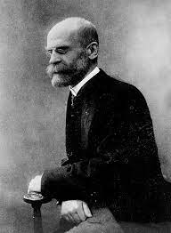
Durkheim
Functionalist
Durkheim proposed that school provides children with three key life skills; social solidarity, skills for work, and society in miniature.
Social Solidarity: The main function of education is the transmission of society’s norms and values. In order for society to function, individuals need to see themselves as part of the wider community. Subjects such as history instil a sense of ‘shared past’ and a commitment to wider society.
Skills for Work: In complex industrial societies, the production of goods and services involves cooperation between a number of different specialists. The education system provides people with skills in order to be able to fit in with the world of work.
Society in Miniature: Schools prepare children for wider society where they will have to cooperate with people who are neither family nor friends. School provides children with a set of rules and this prepares them for following society’s rules.

Slide 18
Evaluation of Durkheim
Durkheim seems to be assuming that there is a shared culture that can be transmitted through education and the hidden curriculum. In a multicultural society, there may not be one single culture to be transmitted.
The education system may not adequately teach specialised skills useful in the workplace.
Marxists would argue that the culture being transmitted through the education system is one that benefits the ruling class and not society as a whole.
Feminists would argue that the culture being transmitted is patriarchal.
Durkheim assumes that students in education will come to accept the values of society that are being taught. This may not be the case for all students.

Slide 19
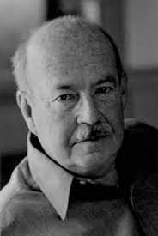
Parsons
Functionalist
Universalistic Values: Parsons argues that schools prepare children for entry into the wider society by treating everyone according to the same universalistic standards. This is different to the particularistic standards that apply in the family. The child’s status in the family is ascribed- it is given to them and they are judged as being ‘good ‘ or bad’ in accordance to the family’s values. However, in wider society people are judged according to universalistic standards which are applied in the same way to everyone. People’s status in society is achieved, for example as a result of educational qualifications and hard work. The education system prepares children for this transition.
Value Consensus: Students are encouraged to value high achievement and the rewards that this brings. Students are also encouraged to believe that they are competing with each other on equal terms in the classroom. Therefore, higher achieving students are seen as deserin their success and the lower achievers accept their lower status as fair.

Slide 20
Parsons
Functionalist
Meritocracy: Parsons saw the education system as being a meritocracy. Students’ achievements are based on their abilities and efforts and not on social class, gender or ethnicity. The education system is seen as treating everyone equally with status being on merit alone. Parsons saw education as mirroring wider society, which he felt was increasingly based on achieved status.
Role Allocation: Parsons argued that the education system is an effective device for sorting people out so that they are matched to the correct job for their abilities. Based on their qualifications, the most able should reach the top jobs in society. This is seen as fair, as the system is meritocratic.

Slide 21
Evaluation of Parsons
Like Durkheim, Parsons is accused of not fully considering whose values are being transmitted via the education system. Marxists, for example, would see these as the values of dominant groups in society.
Many sociologists have questioned the idea that the education system is meritocratic. Feminists, for example, argue that gender can have an influence on achievement and subject choice and that the system does not provide equality of opportunity.
Role allocation has been criticised in the basis that those with the best qualifications do not always get the top jobs and many of the highest financially achieving individuals in society left school with few qualifications.

Slide 22
The Marxist Perspective
The Marxist perspective proposes that society is unfairly biased against the working class as they are continually exploited by the upper-classes. This applies across many areas, including in the workplace, in the family and in education. Marxists see education as a form of informal social control that creates obedient and passive workers for the capitalist economy.

Slide 23
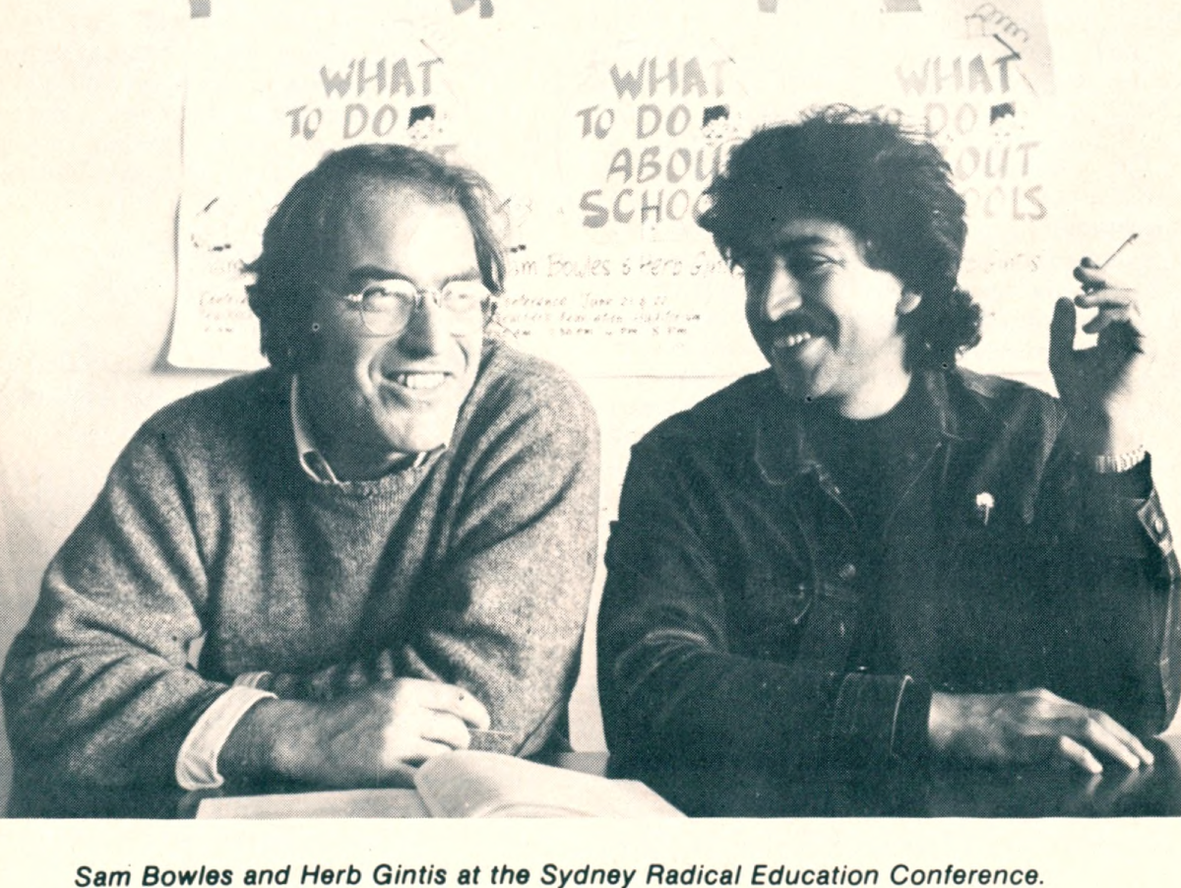
Bowles and Gintis: Myth of Meritocracy
Marxists
Unlike functionalists, Bowles and Gintis reject the idea that the education system is meritocratic. Instead, they argue that we are led to believe that it treats people fairly and equally, as this prevents people questioning the system. Bowles and Gintis describe this as the ‘myth of meritocracy’. They argue that social class background and not intelligence or educational achievement, is the main factor affecting someone’s income. However, the system disguises this fact and leads us to believe that those with the highest incomes deserve to be in this position as a result of their ability and qualifications.

Slide 24
Bowles and Gintis
Marxists
Bowles and Gintis argue that there is a close link, or correspondence, between the relationships and interactions expected and valued in schools and those expected and valued in the workplace.
They describe this as the correspondence principle. For Bowles and Gintis, the needs of the economy influence what happens in the education system.
The correspondence principle operates through the hidden curriculum by teaching the values required by the capitalist system in the following ways:
Students learn to obey rules and not to question them.
Students learn to accept the hierarchy in schools, which prepares them for the workplace
Students learn to be motivated by external rewards in the form of exam results and grades, rather than enjoying the subject. This prepares them for the workplace, where work is also likely not be be intrinsically satisfying.
Students learn to be competitive in schools through tests and grades, this prepares them to compete in the workplace.

Slide 25
Evaluation of Bowles and Gintis
Bowles and Gintis are accused of taking a deterministic view- they assume that students have no free will and passively accept the values taught via the hidden curriculum. However, many students reject the values of the school.
Modern economies and businesses can be seen as requiring a different kind of workforce to the one Bowles and Gintis describe. Instead of passive and unthinking workers, businesses require creative and independent workers capable of taking on responsibility and developing new ideas as part of a team

Slide 26
Inequalities in Education

Slide 27
Educational Inequality and Class: The Trends
When examining social class differences in achievement, the main comparison sociologists make is between working class and middle class pupils. Most sociologists use parental occupation to determine a pupil’s social class, for example:
Middle-class or non-manual occupations include professionals such as doctors or teachers, together with managers and other ‘white collar’ office workers and owners of businesses.
Working-class or manual occupations include skilled workers such as plumbers, semi-skilled workers such as lorry drivers, and unskilled or routine workers such as cleaners.
Inequality between classes in the education system starts in nursery and the gap between working class and middle class students widens as they progress through the educational system.
Research has shown that working class pupils:
Were more likely to fail the 11+ and go to secondary moderns in areas with the tripartite system.
Are more likely to be non-readers when starting compulsory education.
Get lower results in SATs
Are more likely to be placed in lower streams
Get poorer GCSE results
Are more likely to leave school at 16

Slide 28
Labelling, Setting, Deviant Subcultures
Teachers can make judgements about pupils based on early impressions and appearance. This is called labelling.
These can be positive labels (bright, hardworking) or negative labels (dim, lazy). Once given, it is very unlikely that the labeller will change their mind.
The reason that labelling is an issue is that it reinforces a message to a child, they will consistently hear that they are either a good, or even outstanding, student and play up to this, and likewise, if they are consistently labelled as ‘naughty’ or ‘unacceptable’, this could lead to something called a self-fulfilling prophecy. A self-fulfilling prophecy occurs when a student internalises the label they have been given and begin to act on it. Thus, becoming what they have been labelled.
In schools, there may be a group of pupils who have their own norms and values, different from the majority of pupils. These are generally anti-school subcultures. They feel that the rules do not apply to them, and that school is on the whole a waste of their time. These are generally students who have been negatively labelled.

Slide 29
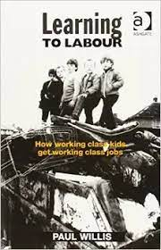
Paul Willis: Learning to Labour
Marxists
Paul Willis used a wide range of research methods - including observations and interviews - to really try and see education from the children's point of view. As a Marxist, he was interested in conflict in education and why working-class children went on to do working class jobs. But he reached quite different conclusions from Bowles & Gintis.
Willis' study of working-class boys in a Midlands school has become a classic. His study focused on "the lads" - a group of working-class boys who were disruptive, misbehaved and had a very negative attitude to education. They had formed what Willis called an anti-school subculture. Within this subculture it was "cool" to "mess about" and to fail. It really turned the values of the school on their head. From the perspective of this subculture, children who the school viewed positively were the "ear'oles" ("swots"). The last thing you wanted was praise from a teacher. Instead, children could get praise within the group for truancy, bad behaviour and discriminatory attitudes (there was a lot of racism, sexism and homophobia within the group).
With these findings, Willis does not only undermine the arguments of Parsons or Durkheim, but also of his fellow Marxists, Bowles & Gintis. First, he concluded that school was not working very well as an agent of socialisation: there was no value consensus here: pupils were actively rejecting the norms and values of society. As such, they were a long way from the hard-working, docile, obedience workers suggested by Bowles & Gintis! And yet the outcome was much the same: the children of working-class parents going on to do working-class jobs. In this study they played an active role in this: they thought school was boring and pointless and was something they had to endure until they could go to work. They had a similar attitude to work, and got through it using similar techniques: "messing about" and "having a laff".

Slide 30
Evaluation of Paul Willis
Critics argue that Willis’ account of the ‘lads’ romanticises them, portraying them as working-class heroes despite their anti-social behaviour and sexist attitudes.
His small-scale study of only 12 boys in one school is also unlikely to be representative of other pupils’ experiences and it would be risky to generalise his findings.
The Hawthorne effect could also be at play here. As the boys knew that Willis was observing them, it is possible that they played up to this and changed their behaviour. Meaning that Willis’ findings may not be a valid representation of working class experiences of education.

Slide 31
Setting, Streaming and Mixed Ability Teaching
There are three main ways in which students are split into teaching groups at secondary school; setting, streaming and mixed ability.
Setting: When you are placed in different classes based on ability.
Streaming: In the same class for all subjects based on average ability.
Mixed Ability: Students of different abilities all working in the same class.

Slide 32
Streaming and Anti-School Subcultures: Ball
One of the effects of streaming and labelling is to divide pupils into those in the top streams ‘the high achievers’ and those in the bottom streams ‘the failures’.
Studies like those of Ball have shown that bottom stream pupils often rebel against the school (denied status) and develop an alternative set of values and attitudes in opposition to the academic values of the school.
This classic case study into secondary education investigated why working-class pupils underperformed at school.
Ball spent three years in Beachside Comprehensive, carrying out a participant observation. He particularly focused on two groups of students, one who had been banded or streamed by ability, and another that was taught in mixed-ability classes. The banding was well-intentioned. There was a concern among teachers that in mixed-ability classes the brightest pupils were held back and the weakest pupils were left behind, with a tendency that it was the middle group of pupils who were focused on. However, Ball found that the process tended to have a negative impact on working-class pupils. He found that pupils who started school with similar attitudes to study began to change when they were banded/streamed, that is, when they were put in classes supposedly based on their ability. Streaming is when pupils of a similar ability are in the same, streamed class for all subjects whereas with setting pupils could be in a high set for Maths and a low set for English (for example). Working-class pupils gravitated towards the lower bands and then became increasingly disinterested in education and "anti-school". The net effect of this was that children from lower-income families left school with fewer qualifications, therefore reproducing class inequalities, apparently by accident. He describes a downward mobility - quite the opposite of what Parsons or Davis and Moore imagined - where attempts at differentiation damage working-class pupils' education and life chances.

Slide 33
Educational Inequality and Class: Internal Factors
Labelling and Self Fulfilling Prophecy
Studies show that teachers often attach labels to students regardless of the pupils’ actual ability or attitude. Instead, they label pupils on the basis of stereotyped assumptions about their class background, labelling working class pupils negatively and middle class pupils positively.
Pupils’ work, conduct and appearance were key factors influencing teachers’ judgements. The teachers saw children from middle class backgrounds as the closest to the ideal, and working class children as furthest away from it as they regarded them as badly behaved.
Studies have shown that teachers labelled working class parents as uninterested in their children’s education, but labelled middle class parents as supportive.
This led to differences in how teachers dealt with pupils they perceived as underachieving-setting extension work for underachieving middle class pupils, but entering working class pupils for easier exams.
This labelling can lead to a self fulfilling prophecy. The self fulfilling prophecy can produce underachievement. If teachers have low expectations of certain children and communicate these expectations in their interaction, these children may develop a negative self concept. They may come to see themselves as failures and give up trying, thereby fulfilling the original prophecy.

Slide 34
Educational Inequality and Class: Internal Factors
Pupil Subcultures
Schools are middle class environments which share the following values.
Formal language (or elaborate code)
Good behaviour
Good manners
Education is highly valued
It is claimed that pupils from working class environments are disadvantaged because they are less likely to have these values and become defiant in school. The difference between the culture of school and that of the outside lives of working class children creates a culture clash leading to an anti-school subculture. This becomes a defence that both teachers and students create when they do badly at school.

Slide 35
Educational Inequality and Class: External Factors (Cultural Deprivation)
Some sociologists claim that the differences in attainment between working class and middle class children is the result of cultural deprivation. They argue that most of us begin to acquire the basic values, attitudes and skills that are needed for educational success through primary socialisation in the family. The basic ‘cultural equipment’ includes things such as language, self discipline and reasoning skills.
According to cultural deprivation theorists, many working class families fail to socialise their children adequately. These children grow up culturally deprived, they lack the equipment needed to do well as school so underachieve.
Language
Bernstein identifies differences between working class and middle class language that influence achievement.
The Restricted Code: the speech code typically used by the working class. It has limited vocabulary and is based on the use of short, often unfinished, grammatically simple sentences. Speech is predictable and may involve only a single work, or even just a gesture instead. The restricted code is context-bound: that is, the speaker assumes that the listener shares the same set of experiences.
The Elaborated Code: typically used by the middle class. It has wider vocabulary and is based on longer, grammatically more complex sentences. Speech is more varied and communicates abstract ideas. The elaborated code is context free: the speaker does not assume that the listener shares the same experiences and so they use language to spell out their meanings explicitly for the listener.
These differences in speech code give middle class children an advantage at school, and put working class children at a disadvantage. This is because the elaborated code is used by teachers, textbooks and exams.

Slide 36
Educational Inequality and Class: External Factors (Cultural Deprivation)
Parental Attitudes
It has been claimed that working class parents have a culture that does not contribute positively to education.
Parents have negative attitudes and expectations of a good education
Parents are more likely to have fewer qualifications
The local school catchment is likely to have worse performing schools.
Middle Class Values | Working Class Values
Desire for control of their lives | Fatalistic attitude of other people being in control of their lives
Emphasis on future planning | Present time orientation- seeing the present as more important than the future and so not having long term goals.
Deferred gratification- make sacrifices now to fulfil future ambitions | Immediate gratification- seeking pleasure now rather than making sacrifices in order to get rewards in the future.
The individual should not be held back by group loyalties | Collective action stressed- people will achieve improvements by sticking together

Slide 37
Educational Inequality and Class: External Factors (Cultural Deprivation) Evaluation
Keddie describes cultural deprivation as a ‘myth’ and sees it as a victim-blaming explanation. She dismissed the idea that failure at school can be blamed in culturally deprived home backgrounds. She points out that a child cannot be deprived of their own culture and argues that working class children are culturally different, not culturally deprived.
She argues that working class children fail because they are put at a disadvantage by an education system that is dominated by middle class values.

Slide 38
Educational Inequality and Class: External Factors (Material Deprivation)
Unlike cultural deprivation theorists, who blame educational failure on the inadequacy of working class subculture, many other sociologists see material deprivation as the main cause of underachievement. The term material deprivation refers to poverty and a lack of material necessities such as adequate housing and income.
Housing
Poor housing can affect pupils’ achievement both directly and indirectly. For example, overcrowding can have a direct effect by making it harder for the child to study. Overcrowding means less room for educational activities, nowhere to do homework, disturbed sleep from sharing beds or bedrooms.
For young children, development can be impaired through lack of space for safe space. Families living in temporary accommodation may find themselves having to move frequently, resulting in constant changes of school and disrupted education.
Diet and Health
Young people from poorer homes have lower intakes of energy, vitamins and minerals. Poor nutrition affects health, for example by weakening the immune system and lowering children’s energy levels. This may result in more absences from school due to illness and difficulty concentrating in class.
Financial Support and The Cost of Education
Lack of financial support means that children from poor families have to do without equipment and miss out on experiences that would enhance their educational achievement. Poor children may have to make do with hand-me-downs and cheaper but unfashionable equipment, and this may result in being isolated, stigmatised or bullied by peers.

Slide 39
Educational Inequality and Gender: The Trends
Along with social class and ethnicity, gender has a major impact on our experience of education. In recent years there have been some important changes in this area. In particular, while both sexes have raised their level of achievement, girls have now overtaken boys.
On the other hand, one area where gender patterns have been slower to change is in subject choice, with boys and girls often opting to study traditional ‘sex-typed’ subjects and courses. Similarly, there is also evidence that schooling continues to reinforce differences in gender identity between boys and girls.
The main questions that interest sociologists in the study of gender differences in education are:
Why do girls now generally achieve better results than boys.
Why do girls and boys opt to study different subjects?
How does schooling help to reinforce gender identities.
Some key points:
Boys and girls are continuing to do better in exams year-upon-year.
Girls achieve higher results than boys in ALL subjects up to GCSE, MOST subjects at A-Level, and now ON AVERAGE at university level.
The government is very concerned about boys’ underachievement and is attempting to address this situation.

Slide 40
Educational Inequality and Gender: External Factors
Impact of Feminism: The feminist movement has improved the rights of women as well as raising expectations and self-esteem of women. Women are no longer strictly bound to the housewife role.
Changes in Women’s Employment: Mitsos and Browne highlight how the growing service sector has created more ‘feminised’ career opportunities for women, e.g. in Health and Social Care, Hospitality and teaching.
Changing Perceptions and Ambitions: Decline of traditional gender roles- stay at home dads and dual earning families. Independence is highly regarded in modern society.
Changes in The Family: Traditional primary ‘female’ socialisation is more suited to the education system. More lone parent families headed by women and dual earning families raise girls’ expectations.

Slide 41
Educational Inequality and Gender: Internal Factors
Equal Opportunities Policies: Feminist ideas have had a major impact on the education system. Policymakers are now much more aware of gender issues and teachers are more sensitive to the need to avoid stereotyping. For example, policies such as GIST (girls into science and technology) encourage girls to pursue careers in these non-traditional areas. Also, the introduction of the National Curriculum in 1988 removed one source of gender inequality by making boys and girls study the same subjects.
Positive Role Models in Schools: There has been an increase n proportions of female teachers and heads. These women in senior positions may act as role models for girls, showing them women can achieve positions of importance and giving them non-traditional roles to aim for.
GCSE and Coursework: Some sociologists argue that changes in the way pupils are assessed have favoured girls and disadvantaged boys. Gorard found that the gender gap in achievement was fairly constant from 1975 until 1989, when it increased sharply. This was the year in which GCSE was introduced, bringing with it coursework. Mitsos and Browne support this view. They conclude that girls are more successful in coursework because they are more conscientious and better organised.
Teacher Attention: French analysed classroom interaction, they found that boys received more attention because they attract more reprimands. Francis also found that while boys got more attention, they were disciplined more harshly and felt picked on by teachers. Swann also found that boys dominate whole-class discussions, whereas girls prefer pair work and are better at listening and cooperating. This may explain why teachers respond more positively to girls.

Slide 42
Educational Inequality and Gender: Internal Factors
Challenging Stereotypes in The Curriculum: Some sociologists argue that the removal of gender stereotypes from textbooks, reading schemes and other learning materials in recent years has removed a barrier to girls’s achievement. Research in the 1970s and 80s found that reading schemes portrayed women mainly as housewives and mothers. Since the 1980s, teachers have challenged such stereotypes. Also, in general, sexist stereotypes have been removed from materials. This may have helped to raise girls’ achievement by presenting them with more positive images of what women can do.
Selection and League Tables: Marketisation policies have created a more competitive climate in which schools see girls as desirable recruits because they achieve better exam results. Jackson notes that the introduction of exam league tables has improved opportunities for girls: high-achieving girls are attractive to schools, whereas low achieving boys are now. Slee argues that boys are less attractive to schools because they are more likely to suffer from behavioural difficulties and are 4 times more likely to be excluded.

Slide 43
Views on Girls’ Achievement
Liberal Feminist
Sharpe’s research compared the attitudes of girls in the 1970s to those of the 1990s. Rather than valuing marriage, love and husbands, as had been the case in the 1970s, attitudes had changed and girls valued careers and being able to support themselves.
Radical Feminists
Argue the system remains patriarchal despite improved achievement for girls. Girls still experience sexism in schools, subject areas still under represent womens achievement and male teachers are more likely to become heads of secondary schools,

Slide 44
Boys and Achievement: Subcultures
Some sociologists argue that the growth of ‘laddish’ subcultures has contributed to boys’ underachievement.
Epstein examined the way masculinity is constructed within school. She found that working class boys are more likely to be harassed, labelled and subjected to homophobic abuse if they appear to be ‘swots’.
This supports Francis’ finding that boys were more concerned than girls about being labelled as swots because this label is more of a threat to their masculinity than it is to girls’ femininity.
This is because, in working class subcultures, masculinity is equated with being tough and doing manual labour. Non-manual work, school-work, is seen as effeminate and inferior.
According to Francis, laddish culture is becoming increasingly widespread. She argues that this is because girls move into traditional masculine boys become increasingly laddish in their efforts to construct themselves as non-feminine.

Slide 45
Boys and Achievement
Boys and Literacy: The gender gap is mainly the result of boys’ poor literacy and language skills. One reason for this may be that parents spend less time reading to their sons. Another may be that it is mothers who do most of the reading to young children, who thus come to see reading as a feminine activity. In addition, boys’ leisure pursuits, such as football, do little to help develop their language and communication skills. By contrast, girls tend to have a ‘bedroom culture’ centred on staying in and talking with friends.
Decline of Traditional Men’s Jobs: Since the 1980s, there has been a significant decline in heavy industries such as iron and steel, mining and engineering. This is partly the result of globalisation, which has led to mich manufacturing industry relocating to developing countries such as China to take advantage of cheap labour. Traditionally, these sectors of the economy mainly employed men. Mitsos and Browne claim that this decline in male employment opportunities has led to an ‘identity crisis for men’. Many boys now believe that they have little prospect of getting a ‘proper’ job. This undermines their motivation and self-esteem and so they give up trying to get qualifications.
Feminisation of Education: Sewell reported that boys fall behind because education has become ‘feminised’. That is, schools do not nurture ‘masculine’ traits such as competitiveness and leadership. Instead, they celebrate qualities more closely related with girls, such as methodical working and attentiveness.
Shortage of Male Primary School Teachers: The lack of male role models both at home and in school is said to be the cause of boys’ underachievements. Some argue that the culture of education has become feminised as a result of being staffed by female teachers.

Slide 46
Gender and Subject Choice: The Trends
There continues to be a fairly traditional pattern of ‘boys’ subjects’ and ‘girls’ subjects’. Boys still tend to opt for subjects like maths and physics, while girls are more likely to choose modern foreign languages, for example.

Slide 47
Gender and Subject Choice: Explanations
Gender Role Socialisation | Gender role socialisation is the process of learning the behaviour expected of males and females in society. From an early age boys and girls are dressed differently, given different toys and encouraged to take part in different activities. As a result of this socialisation, boys and girls develop different tastes in reading. Boys are more likely to read hobby books and information texts, whereas girls are more likely to read books about people. This helps to explain why boys prefer science subjects and girls prefer subjects such as English. Some sociologists also believe that ‘gender domains’ are influenced by early socialisation. Gender domains are the tasks and activities that boys and girls see as male or female ‘territory’ and therefore as relevant to themselves. Children are more confident when engaging in tasks that they see as part of their own gender domain. For example, when they are set the same maths task, girls are more confident in tackling it when it is presented as being about food or nutrition, whereas boys are more confident when it is about cars.
Gendered Subject Images | The gender image of a subject affects who will want to choose it. Some sociologists argue that some subjects are seen as ‘boys’ subjects’ and others are seen as ‘girls’ subjects’. For example, science is seen as a ‘boys’ subject’ because: Science teachers are more likely to be men The examples teachers use, and those in textbooks, often draw on boys’ rather than girls’ interests In science lessons, boys monopolise apparatus and dominate the laboratory, acting as if it is ‘theirs’.

Slide 48
Gender and Subject Choice: Explanations
Gender Identity and Peer Pressure | Subject choice can be influenced by peer pressure. Other boys and girls may apply pressure to an individual if they disapprove of his or her choice. For example, boys tend to opt out of music and dance because such activities fall outside of their gender domain and so are likely to attract a negative response from peers.
Gendered Career Opportunities | An important reason for differences in subject choice is the fact that employment is highly gendered: jobs tend to be sex-typed as ‘men’s’ or ‘women’s’. Women’s jobs often involve work similar to that performed by housewives, such as childcare and nursing. Women are concentrated in a narrow range of occupations. Over half of all women’s employment falls within only four categories: clerical, secretarial, personal services and occupations such as cleaning. The sex-typing of occupations affects boys’ and girls’ ideas about what kinds of jobs are available or acceptable, for example, if boy’s get the message that nursery nurses are female, they will be less likely to opt for a course in childcare.

Slide 49
Educational Inequality and Ethnicity: The Trends
An ethnicity or ethnic group is a grouping of people who identify with each other on the basis of perceived shared attributes that distinguish them from other groups. Those attributes can include a common nation of origin, or common sets of ancestry, traditions, language, history, society, religion, or social treatment
There are inequalities in the educational achievements of different ethnic groups. For example, white students and Asian students on average do better than black students.
There are also important gender and class differences within and between ethnic groups. Among all groups other than Gypsy/Roma and Traveller children, girls do better than boys. Similarly, within each ethnic group, middle class children do better than working class children.

Slide 50
Educational Inequality and Ethnicity: External Factors (Cultural Deprivation
Language
Cultural deprivation theorists see the lack of intellectual and linguistic skills as a major cause of underachievement for many minority children. They argue that many children from low-income black families lack intellectual stimulation and enriching experiences. This leaves them poorly equipped for school because they have not been able to develop reasoning and problem solving skills.
There is also some concern that children who do not speak English at home may be held back educationally, however official statistics show that this is not a major factor.
Attitudes and Values
Cultural deprivation theorists see lack of motivation as a major cause of the failure of many black children. Most children are socialised into the mainstream culture, which instils ambition, competitiveness and willingness to make the sacrifices necessary to meet long term goals. This equips them for success in education. By contrast, cultural deprivation theorists argue, some black children are socialised into a subculture that instils a fatalistic, ‘live for today’ attitude that does not value education, and leaves them unequipped for success.
Family Structure and Parental Support
The failure to socialise children adequate is the result of dysfunctional family structure. Some sociologists argue that many black families are headed by a lone mother, their children are deprived of adequate care and struggle financially in the absence of a male breadwinner. Other sociologists see that the lack of male role model as a reason for boys’ underachievement.

Slide 51
Educational Inequality and Ethnicity: External Factors (Material Deprivation
Material deprivation means a lack of those physical necessities that are seen as essential for life in today’s society.
Material deprivation explanations see educational failure as resulting from factors such as substandard housing and low income. Ethnic minorities are more likely to face these problems. For example,
Almost half of all ethnic minority children live in low income households, as against a quarter of white children
Ethnic minorities are almost twice as likely to be unemployed compared with whites.
Ethnic minority households are around three times as likely to be homeless.
Almost half of Bangladeshi and Pakistani workers earned under £7 per house, compared with only a quarter of white British workers.
However, even Indian and Chinese pupils who are materially deprived still do better than most. For example, in 2011 86% of Chinese girls who received free school meals achieved 5 or more higher grade GCSEs, compared with only 65% of white girls who were not receiving free school meals.

Slide 52
Educational Inequality and Ethnicity: Internal Factors
Labelling and Teacher Racism
When looking at ethnic differences in achievement, sociologists focus on the different labels teachers give to children from different ethnic backgrounds. There studies show that teachers often seen black students as being far from the ‘ideal pupil’ as they are seen by teachers as disruptive.
Institutional Racism
Institutional racism is discrimination that is built into the way institutions such as schools and colleges operate. An example of institutional racism is the ethnocentric curriculum. The term ethnocentric curriculum describes an attitude or policy that gives priority to the culture and viewpoint of one particular ethnic group. Examples of the ethnocentric curriculum include languages, literature, music, history and school holidays.
Ethnocentric Curriculum
The British school system is based on white culture, books, music holidays etc. Make ethnic minorities feel unrepresented in the system

