Slide 1
GCSE Sociology
Families (Paper 1)
Key Information

Slide 2
Family Patterns

Slide 3
Types of Marriage
Sociologists define marriage as a socially supported union involving two or more individuals in what is regarded as a stable, enduring arrangement typically based on, at least in part, a sexual bond of some kind.
Type of Marriage | Definition
Monogamy | Being married to just one person at a time.
Serial Monogamy | When a divorced person enters a second married, then divorces, remarries and so on.
Bigamy | Marrying when already married to someone else- a criminal offence in the UK
Polygamy | The practice of having more than one spouse at the same time.
Arranged Marriage | A marriage planned and agreed by the families of the couple concerned.
Civil Partnership | A legally recognised union with rights similar to those of marriage.
Polyandry | When a woman has two or more husbands at once.
Polygyny | When a man has two or more wives at once.

Slide 4
Types of Family
One possible definition of a family is a group consisting of a married couple and their dependent children who all live together.
Type of Family | Definition
Nuclear Family | A husband, wife and their child(ren) who all live together (cereal packet family).
Extended Family | A household with a nuclear family and other relatives, such as grandparents.
Reconstituted Family | Created when divorced people remarry, the household is made up of step-parents and step-children.
Lone-Parent | A household is which one parent lives with their child/children.
Empty-Nest Family | A household where children leave the family home to pursue other avenues.
Modified Extended | Relatives who do not live geographically close but maintain regular contact.
Same-Sex Families | Parents of the same sex, some have children through IVF or adoption.

Slide 5
Alternatives to Family Living
One-Person Households
Over the last 30 years, the number of one-person households in the UK has increased significantly.
In 1996, there were 6.6 million and by 2015 there were 7.7 million (nearly 30% of all households).
This increase is partly due to the changing age structure of the population. People are living longer, so there are more elderly one-person households. There has also been an increase in solo living amongst younger people; remaining single and childless, divorced, migrants or students, living alone before marrying, living apart together.
Friends as Family
One view is that families are less central in our lives and are increasingly being replaced by friends. For example, friends rather than family may provide us with emotional support and nurture. However, some researchers argue that many people turn to their family rather than friends when they need support. It may be that friends are becoming more like family rather than replacing them.
Looked After Children
In 2015, local authorities looked after nearly 70,000 children.
Around 75% of looked after children are placed with foster carers, others are placed in children’s homes or secure units (homes that house children who have committed an offence)
Some older people live in institutions such as residential care and nursing homes.

Slide 6
Family Life in a Global Context
Communes
Small community whose members share in the ownership of property and the division of labour.
Kibbutz
An intentional community in Israel. Traditionally there is no private property, meals are eaten together and they raise their children communally.
China’s One-Child Policy
Introduced in 1979 with the aim of reducing the birth rate of China. The traditional preference for male children together with the one-child policy led to large numbers of girls being abandoned, place in orphanages, sex-selective abortions or even cases of female infanticide. In 2013 the rules were changed to allow couples to have a second child if one parent is an only child.

Slide 7
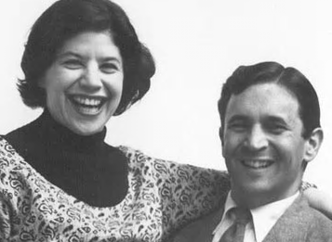
Rapoport and Rapoport (1982)
Family Diversity
Carried out groundbreaking research into family life.
They identified a number of ways in which family life was diverse, in contrast to the idea that the nuclear family was the clear norm.
Organisational: This refers to the way a family might organise itself in terms of the roles people perform (e.g. traditional male-dominated families and more symmetrical ones).
Cultural: Families differ in terms of their beliefs and values. One example of this is between different ethnic groups, with some ethnicities placing a greater emphasis on family than others, some preferring different gender roles, etc.
Class: Availability of resources, quality of housing, leisure opportunities, etc. all impact the nature of families and family life.
Life Course: We do not live in the same family structure for the whole of our lives.
Cohort: Families change over time, what is the norm for one generation is not for the next.

Slide 8
Evaluation of The Rapoport’s
The neo-conventional family is still the most common family type. A neo-conventional family is a dual-earner family in which both spouses go to work, they are similar to nuclear families but do not have the traditional structure of mother, father and children. However, the family members perform similar functions to those of traditional families.
Due to the life cycle, many people will still be part of a nuclear family in some way. Single parent households and reconstituted families are formed from nuclear families.
Both of these points suggest that there is not as much diversity as the Rapoports suggest.

Slide 9
The Nuclear Family
The nuclear family is seen by many os the most natural, most common and best type of family arrangement.
The media and politicians over-emphasise the frequency and value of the nuclear family, showing a stereotype based on truth, but misleading in its frequency. The stereotypical nuclear family consists of heterosexual parents with two children.
Statistics show that this type of family is on the decline.
Reason for Decline | Explanation
Ambition | Women’s ambitions have changed from home and family life to careers and employment.
Secularisation | The church has lost he majority of its power with the societal belief of marriage becoming irrelevant and many family types no longer being stigmatised.
Changing Laws | The Divorce Reform Act and The Same Sex Couples Act have made alternatives to nuclear families easier.
Changing Societal Views | Same sex families, cohabiting families and childless couples are now more accepted than in the past.

Slide 10
Lone-Parent Families
The number of lone-parent families in the UK has increased since the 1970s. More recently the proportion has remained fairly stable, at about 25% of family households.
The majority of lone-parent families are matrifocal. There is also evidence that African-Caribbean communities have a higher than average proportion of lone-parent families.
Explanations for The Increase
Increase in Divorce: An increase in divorce rates means that more children live with one parent in lone-parent families.
Changing Attitudes: Being a single parent is now much more accepted and less stigmatised than it was in the past.
Changing Priorities and Increased Freedoms: With more women in the workforce they now have more financial freedom. This means that more women can afford to be single mothers and are much less likely to stay in unhappy relationships for financial reasons.
Negative Effects of Lone-Parent Families
The New Right see the lone-parent family as ‘broken’ or ‘fractured’. They argue that lone-parent families, especially those headed by women, create children who lack discipline and are emotionally disturbed. They would also argue that lone-parent families:
Cause an excessive dependency on the welfare state.
Undermine the sexual division of labour which gives each parent a dedicated role to fulfil.
Causes the absence of the male whose instrumental role was that of breadwinner and role model.
Charles Murray argues that it has led to the growth of fatherless families and ill-disciplined children who are draw to a life of crime.

Slide 11
Serial Monogamy
Many people now marry, divorce and remarry, sometimes multiple times. Some people suggest this is evidence of the decline in the importance of marriage. However, others argue that these people are not rejecting marriage as such, but the partner they are with.
‘Serial Monogamy’ is the term used to describe people who marry more than once. Over 30% of marriages in 2019 were remarriages.
Marriage
With the increase in divorce rates, it would be fair to assume that the number of marriages must have increased over time. However, official statistics show that the overall number of marriages is actually decreasing. People are also choosing to marry later in life. The average age of marriage for a women in 1971 was 22, however in 2019 it was 30.
Reasons for The Decline | Explanation
Education and Employment | Women are now more involved in the workforce and stay in education for longer. Therefore, their priorities have changed from marriage to careers.
Financial Stability | Due to more women entering the workforce, they are now more financially stable. This means that they do not need to get married for financial reasons.
Social Attitudes | Social attitudes around unmarried couples and women not getting married have changed. It is now much more accepted by society to remain unmarried.

Slide 12
Divorce
There is a rising divorce rate, roughly half of all marriages that occur in 2022 will result in divorce by 2025.
Divorce | The legal termination of a marriage.
Separation | When spouses stop living together without being divorced.
Empty-Shell Marriage | Marriage in which the couple continue to live together even though the marriage has broken down.
According to the Office of National Statistics:
There were 107,599 divorces of opposite sex couples in 2019
There were 822 divorces among same-sex couples in 2019.
In 2019, the average duration of marriage at the time of divorce was 12.3 years for opposite sex couples.
However, while the number of divorces increased in 2019, there has been an overall downward trend since the most recent peak in 2003:
Fewer people are getting married in the first place.
Increasing house prices mean people stay together for economic reasons.
An increase in immigration- immigrants are less likely to get divorced

Slide 13
Cohabitation
Cohabitation involves an unmarried couple in a sexual relationship living together. While the number of marriages is falling, the number of couples cohabiting continues to increase and is the fastest growing family type in the UK.
There are over two million cohabiting couples in Britain. About a quarter of all unmarried adult under 60 are now cohabiting- double the number in 1986.
For some, cohabitation is a trial marriage. For example, during times of global recession a couple may live together to save up to get married.
Reasons for The Increase | Explanation
Changing Views | Society’s opinions around cohabitation have changed, the increase rate of cohabitation reflects society’s changing views around sex outside of marriage.
Secularisation | Young people with no religion are more likely to cohabit than those with a religion. The declining influence of religion has removed barriers to cohabitation.
Women’s Employment | Women have less need for the financial security of marriage and are freer to opt for cohabitation.

Slide 14
Births Outside of Marriage
In 1988, 25% of all births in the UK were outside marriage, by 2006 this had risen to 44%.
Births outside of marriage are no longer stigmatised, for example terms such as shotgun wedding and illegitimacy are no longer common place.
Much of the increase in births outside marriage results from rising numbers of babies born to cohabiting partners. A high proportion of unmarried mothers are living with their child’s father at the time of birth. In 2014, around 1 in 3 babies were born to unmarried parents who lived together.

Slide 15
The Extended Family
In 1957, Willmott and Young found that the extended family was thriving .
However, recent changes in society e.g. mobility and improved communication techniques have led to the emergence of the modified extended family. Whereby, family members do not live geographically close to each other but remain in contact and continue to provide support.
The extended family supports individuals by:
Grandparents providing childcare
Fathers doing DIY in the homes of adult children
Adult children caring for older parents
Adult grandchildren helping grandparents
Middle aged parents providing financial support for adult children.
In recent years there has also been an increase in boomerang children, young people who leave home and then return to live with their parents. This has increased in recent years with increasing house prices and large levels of debt incurred by students.

Slide 16
Ethnicity and Social Class
Immigration has had a major impact on the diverse family forces that we see in Britain today. For example, statistics have shown in families with African/Caribbean culture, often the mother is financially independent and raises the children alone, this is known as a matrifocal family, where the mother heads the family.
In families from the Indian subcontinent, it has been found that extended families are strong, with three generations frequently living in the same household; also arranged marriages are traditional and still frequently used.
An arranged marriage is where parents select their partner for their child, in some families it is a source of conflict but often, a compromise is met where the parents draw up a short list and their child chooses from that list.
This can be very difficult for people from second and third generation immigrant families as they are torn between two cultures.
Some sociologists also argue that relationships within families vary according to social class. There is some evidence to suggest that middle class role relationships are more equal than working class ones, however some evidence suggests that working class fathers are more involved in childcare than middle class fathers.

Slide 17
Birth Rate and Fertility
Not only are fewer women having children now, fewer women are choosing to have children. Birth rates have dropped to to 1.56 children per family in 2020. The birth rate is calculated by live-births per 1000 women.
The fertility rate has dropped dramatically (deferring childbirth leads to fertility problems). Fertility rate is the number of live births per 100 women of child-rearing age.
There has been a change in attitudes within society. This means that there is now much more tolerance for births outside of marriage. Childlessness is now also seen as acceptable within society. This is where women choose not to have children at all. Birth control has also become much more readily available for people. For example, contraception is now readily available on the NHS and comes in many different forms. This means that a couple can have a sexual relationship without having to worry about getting pregnant.
Women also have more employment opportunities these days. This means that many of them are delaying having children, or choosing now to have children at all, in order to focus on their careers. Our values have also changed. We are now more individualistic and desire individual freedom.
Other reasons for changes in fertility include:
Uncertainty in the job market
People getting married at a later age
Women’s increased participation in higher education

Slide 18
Ageing Population
The average age of the UK is rising. In 1971, it was 34.1, by 2013 it was 40.3 and it is expected to rise to 42.8 by 2037.
There are fewer young people and more old people.
Caused by 3 factors:
Increasing life expectancy- people are living longer
Declining infant mortality- hardly anyone dies early in life
Declining fertility- fewer young people are being born
Effects
Public Services: Older people consumer a larger proportion of public services (particularly true of the old old)
One-person pensioner households
The dependency ratio: as the number of retired people increases, so too does the burden on the working population. However, we must be careful not to overgeneralise. Some people work well into old age, and the retirement age is rising. Also, the decreasing fertility rate offsets the dependency ratio of older people.

Slide 19
Migration
Immigration: movement into a society
Emigration: movement out of a society
Net migration: the difference between the numbers of migrants and the numbers of emigrants
One consequence is a more ethnically diverse population, in 2011 ethnic groups accounted for 14% of the population, this causes a greater diversity of family patterns.
Immigrants are more likely to be of working age and therefore help lower the dependency ratio
Immigrants also are younger and have more children, increasing the ratio (however eventually lowering as they work themselves).

Slide 20
Perspectives of The Family

Slide 21
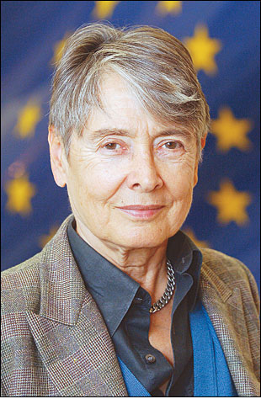
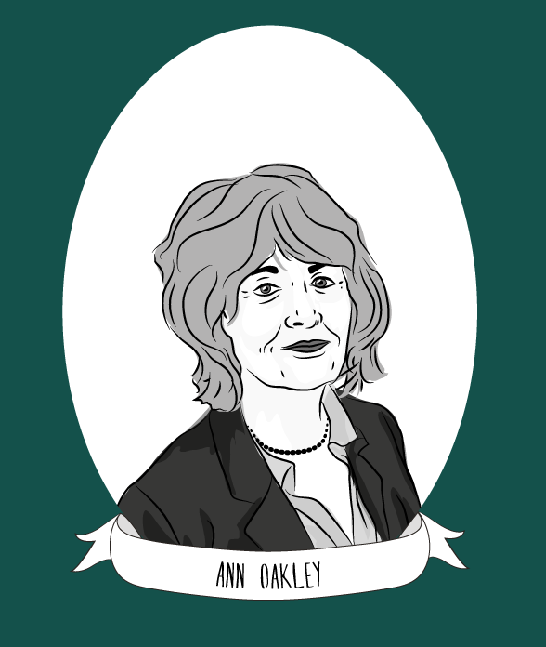
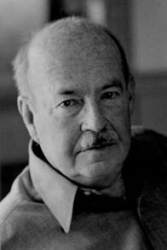
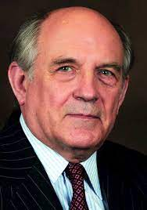
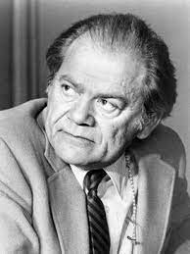

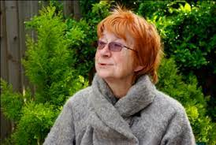
Perspectives of The Family
Consensus/Positive Views of The Family | Conflict/Negative Views of The Family
Functionalist: the family performs positive functions for society and the individual. | Marxist: the family provides important functions for capitalism.
New Right: the nuclear family is the cornerstone of society but is under threat. | Feminist: the family reinforces gender inequality and the patriarchy.

Slide 22

Talcott Parsons (1959)
Functionalist
Focused on the middle class nuclear family in the US.
Nuclear family performs two basic and irreducible functions- common to all societies:
  Primary Socialisation
  Stabilisation of Adult Personalities
Warm bath analogy: family is seen as a place of refuge, created by the mother whereby being part of a family is like stepping into a warm bath.
Argues that father and mother’s roles in the family are complimentary:
  Instrumental Role of the father- men are suited to this role as breadwinner and provider for the family’s physical needs.
  Expressive Role of the mother- women are suited to this role as carer and nurturer, providing for emotional needs.
Consensus Theory

Slide 23
Evaluation of Parsons
Parsons’ view of the socialisation process can be seen as deterministic, with children being force fed culture. Parsons ignores the possibility socialisation is a two-way process in which attempts at socialisation can be resisted by children.
The Marxist Zaretsky would argue that the family only provides emotional support to its members in order to encourage its members to work another day under the harsh realities of capitalism. The family therefore serves capitalism by looking after the needs of exploited workers at no cost to employers.

Slide 24
Murdock
Functionalist
The family is a universal institution (it exists everywhere) and it performs 4 major functions:
  Sexual Function preventing the social disruption caused by sexual ‘free-for-all’
  Reproduction of the next generation without which society would not continue.
  Socialisation of the young into society’s shared norms and values
  Meeting its member’s economic needs, for example shelter and food.
Consensus Theory

Slide 25
Evaluation of Murdock
Feminists and Marxists reject this ‘rose-tinted’ view that the family meets the needs of both the individual and society. They argue that functionalism neglects conflict and exploitation:
  For example, feminists see the family as serving the needs of men and oppressing women.
  Marxists argue that the family meets the need of capitalism, not those of family members or society as a whole.

Slide 26
Evaluation of The Functionalist View
Functionalist analyses of the nuclear family tend to be based on middle class and American versions of the family and they consequently neglect other influences such as ethnicity, social class or religion. For example, Parsons does not consider the fact that wealth or poverty may determine whether women stay at home to look after children or not. Religious or ethnic subcultural differences may mean that Parsons’ version of the family is no longer relevant in contemporary society.
Feminists argue that as a result of this picture of the family, functionalists tend to ignore the ‘dark side’ of the family- conflict between husband and wife, male dominance, child abuse and so on. They do not give enough attention to the harmful effects that the family may have on wider society.

Slide 27


The New Right
Political View
The New Right believe that nuclear families should be segregated, meaning that family roles have been allocated due to gender differences.
They believe that the decline in the nuclear family is having a major negative effect on society, causing issues such as a growing crime rate and drug abuse problems.
They believe that many of society’s problems are caused by:
  Contraception and abortion
  Divorce and cohabitation
  Lone-parent families
  More illegitimate births
  Working mothers
New Right sociologists also propose the idea of an ‘underclass’ of people: they have different norms and values from the majority of society, where issues such as teenage pregnancy and welfare dependency are rife.
Consensus Theory

Slide 28
Evaluation of The New Right
The New Right perspective on the family is quite vague, it points to more issues in society than issues in the family.
Marxists would argue that the underclass exists because they have been exploited for cheap labour and become outcasts in society, labelling them the lumpenproletariat.
Consensus Theory

Slide 29
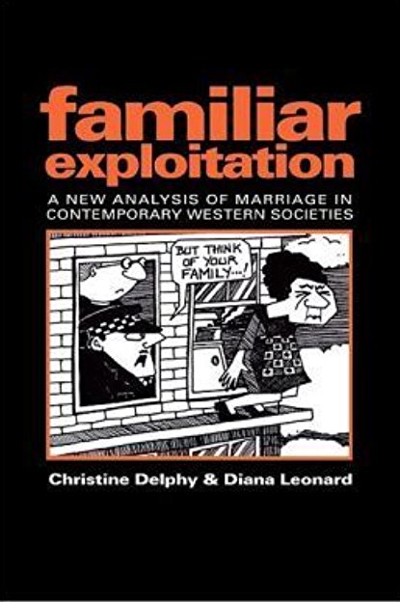
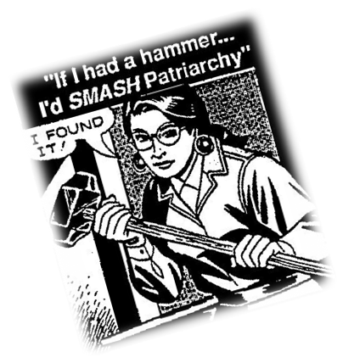
Delphy and Leonard (1992)
Radical Feminists
Emphasise the importance that work plays in gender inequalities.
The family plays a major role in maintaining and reinforcing patriarchy.
Family is an economic system involving a division of labour which exploits women but benefits men.
For example, women may be employed outside the home but are still expected to do domestic chores when they get home- work is not shared equally with their male partners.
The family is based on a hierarchy. The husband is at the top and other family members are in a subordinate position.
The husband provides for his wife’s upkeep and gets to control her labour for his own use.
Families maintain men’s dominance over women and children, patriarchal families maintain the patriarchal nature of society.
Conflict Theory

Slide 30
Ann Oakley (1982)
Liberal Feminist
Addresses the idea of conventional families- ‘nuclear families composed of legally married couples, voluntarily choosing the parenthood of one or more children’.
Examines the strains of being conventional and social control.
Oakley critically examines the idea of conventional families. She looks at the work of other sociologists and considers where the idea that this is a ‘normal’ way to live came from, and the influence it has over society and individuals.
She considered the way the conventional family worked as a form of social control: people were expected to live in these families, and this controlled them by making it harder to live alternative lives.
However, she notes that conventional family stereotypes are increasingly seen as dated and some groups are looking towards alternative ways of living.
Conflict Theory

Slide 31
Evaluation of The Feminist Perspective
Some feminist theories have dated badly as they fail to take into account for recent economic and social changes, such as the feminisation of the economy, educational successes of young women, women’s use of divorce, etc.
Feminists also ignore the positive aspects of the family and are instead preoccupied with the negative side of family life. They ignore the possibility that many women may enjoy running a home and raising children.
Marxists would argue that feminists ignore the class conflict between capitalism and the family.

Slide 32
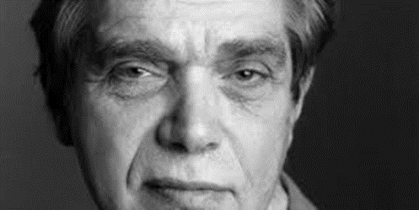
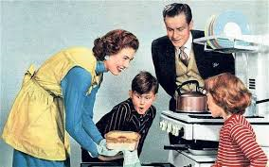
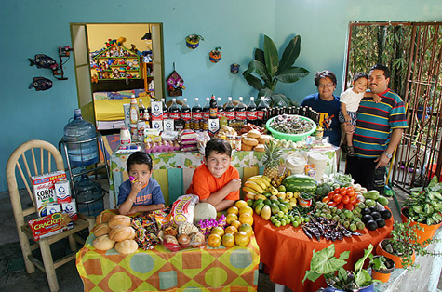
Eli Zaretsky (1976)
Marxist
Capitalism has created an illusion that the economy is separate from the ‘private life’ of the family.
The family is unable to provide psychological and social needs of the individual.
The family supports the capitalist economy:
  It relies on the housewife role as unpaid labour and reproducing the next generation of workers.
  It acts as a vital unit of consumption- families spend a lot of money in the economy.
Only socialism (getting rid of capitalism) will end the artificial separation of family and public life, making personal fulfilment possible.
Conflict Theory

Slide 33
Evaluation of Zaretsky
Feminists would argue that Zaretsky exaggerates the extent to which the family acts as a refuge. They would say that he ignores the cruelty and violence within families.
Functionalists argue that Marxists ignore the benefits that the family provides for its members, such as mutual support.

Slide 34
Relationships Within The Family

Slide 35
Conjugal Roles
Conjugal roles are the roles that each parent has within a household. Examples include, driving, cooking, cleaning, DIY and childcare.
Segregated Conjugal Roles | Joint/Integrated Conjugal Roles
Males and females have clearly separate roles, for example males do the DIY and go to work, whereas women do the cooking, cleaning and childcare. Some sociologists argue that this type of family is on the decline. | Males and females share domestic tasks such as childcare, decision making and income earning. Some sociologists argue that this type of family is increasing as women enter the workforce and work (often full time).
Functionalists, such as Parsons, argue that the different roles that parents play are important for the primary socialisation process. They argue that men play an instrumental role as the breadwinner, and women play an expressive role as housewife and mother.
However, feminists would argue that women are now working full time and have careers. This theory is outdated because most women do not simply stay in the house all day, they perform a triple shift, meaning that they are exploited by men within the family for their free labour.

Slide 36
New Roles for Men
Some sociologists argue that, with the increase in the number of women working, men have had to adopt new roles within the family.
New Men:
Work full time like their wives and share household tasks equally.
Despite much publicity, there are very few of these ‘new men’ about and it is almost unheard of for both partners to work and the responsibility of the home be shared 50/50, or be the man’s.
House-Husbands:
Role reversal: women go to work and men stay home and look after the children/ the home.

Slide 37
Are Couples Becoming More Equal?
Most of the women in Ann Oakley’s study in the 1970s were full-time housewives, but today many more wives go out to work, either full time or part time.
This trend of both partners working raises two questions:
Is it leading to a more equal division of labour with a ‘new man’ taking on responsibility and doing an equal share of housework?
Does it simply mean women now have to carry a ‘dual burden’ of paid work as well as domestic work?

Slide 38
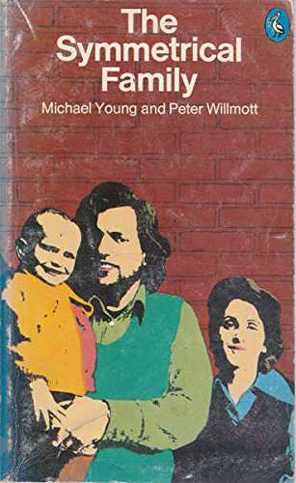
Willmott and Young (1973)
Functionalist
Conducted interviews of nearly 2000 people in Greater London and surrounding areas.
Nuclear family: home centred and privatised; more time spent with the family.
Symmetrical roles- less segregated and more equal. Household chores and decisions; not interchangeable but equally important.
Hold a ‘march of progress’ view that there is a more equal division of labour in the home.
Reasons for the rise in symmetrical families
Money- increase in male wages and employment in women; better living standards
Decrease in male mortality and unemployment rate
Increased geographic mobility
Less children- enables wives to go to work. Economic equality between the spouses.
Consensus Theory

Slide 39
Are Couples Becoming More Equal?
Couples ARE becoming more equal
Gershuny argues that women working full time is leading to a more equal division of labour in the home. He found that women who worked full time did less domestic labour than other women.
The British Social Attitudes Survey found a fall in the number of people who think it is a man’s job to earn money and the women’s job to look after the home and family.

Slide 40
Are Couples Becoming More Equal?
Couples ARE NOT becoming more equal
Sullivan found a trend towards women doing a smaller share of the domestic work and men doing more. Her analysis showed an increase in the number of couples with an equal division of labour and that men were participating in more traditional ‘women’s tasks’.
The British Social Attitudes Survey found that in 2012 men on average did 8 hours of housework a week, whereas women did 13 hours. Men spent 10 hours on care for family members, whereas women spent 23 hour. 60% of women felt this division of labour was unjust because they were doing more than their fair share of housework.
The British Social Attitudes Survey found that couples continue to divide household tasks along traditional gender lines. For example, women were much more likely to do the laundry, care for sick family members, shop for groceries, do the cleaning and prepare meals, while men were more likely to do small repairs around the house. These patterns were much the same as they had been in 1994.
Boulton points out that although fathers may help by performing specific childcare tasks, it is usually the mother who takes responsibility for the child’s security and well-being.
Braun, Vincent and Ball found that in only three families out of 70 studied was the father the main caregiver. Most were ‘background fathers’; helping with childcare was more about their relationship with their partner than their responsibility to their children.

Slide 41
Childhood
The 1851 Census found that 36%of male and 20% of female children aged 10-14 were in employment.
Aries: In the Middle Ages children were not seen as any different from adults. They had the same rights, duties and skills as adults.
Shorter: High death rates encouraged indifference and neglect, e.g. it was not uncommon for a child to be given the name of a dead sibling.
Reasons for Changes in The Position of Children
Laws restricting child labour and excluding children from paid work. Children went from being economic assets to being an economic liability, financially dependent on their parents.
The introduction of compulsory schooling in 1880 had a similar effect, especially for the children of the poor.
Child protection and welfare legislation such as the 1889 Prevention of Cruelty to Children Act and the 1989 Children Act made the welfare of children the fundamental principle underpinning the work of agencies such as social services.
Laws and policies that apply specifically to children such as minimum ages for a wide range of activities, from sex to smoking, have reinforced the idea that children are different from adults and so have different rules applied to their behaviour.

Slide 42
Childhood
Toxic Childhood
UK youth have above average rates for obesity, self-harm, drug and alcohol abuse, violence, early sexual experiences and teenage pregnancies.
A UNICEf survey ranked the UK 16th out of 29 for children’s well-being.
Pilcher argues that rapid technological development and cultural changes in the last 30 years have damaged children’s emotional, physical and intellectual development.
These changes range from junk food, computer games, and intensive marketing to children, to the long hours worked by parents and the growing emphasis on testing in education.

Slide 43
Power Relationships
Resources and Decision Making
Willmott and Young argued that with the growth of the symmetrical family, there was more financial equality between partners. However, Delphy and Leonard argue that the family is hierarchical and patriarchal.
Pahl found that husbands are more likely to be dominant in decision making and as such can be seen as weidling more power in relationships.
Domestic Abuse
Domestic violence can be seen as a form of power and control. It is estimated that 1 in 4 women is abused during her lifetime, with 2 women being killed every week by her partner.
Some critics of functionalism highlight the apparent increase in violence within the home in order to show that families are not necessarily safe havens for their members.

Slide 44
The Conventional Family (Anne Oakley)
‘Nuclear families composed of legally married couples, voluntarily choosing the parenthood of one or more (but not too many) children. Parents and children reside together as a distinct domestic unit’.
Oakley points out that the conventional family is no longer the norm in statistical terms, however it is still a powerful idea in society.,
Family members have different roles based on their age, occupation and gender
Women are expected to work inside the home without pay, while men are expected to work outside of the home for pay (they are dependent on their husbands income)
People expect the conventional family to bring happiness however there are strains. Women may experience depression or dissatisfaction with housework, while men may experience stress of being the breadwinner.
Some groups, particularly the educated middle classes are exploring other ways of living. There has been an increase in dual worker families and lone parent families. However, norms are not changing across all social groups.

