Slide 1
Multi-store model of memory
Theory of reconstructive memory
Memory
NAMED THEORIES
Gibson’s direct theory of perception
Gregory’s constructivist theory of perception
Perception
Piaget’s stage theory
Dweck’s mindset theory
Willingham’s learning theory
Development
Milgram’s agency theory
Adorno’s authoritarian personality
Social Influence
Piaget’s theory: language depends on thought
The Sapir-Whorf hypothesis
Darwin’s evolutionary theory of non-verbal communication
L,T&C
James-Lange theory of emotion
Hebb’s theory of learning and neuronal growth
Brain and Neuropsychology
Biological explanation + treatment of depression
Psychological explanation + treatment of depression
Biological explanation + treatment of addiction
Psychological explanation + treatment of addiction
Psychological Problems

Slide 2
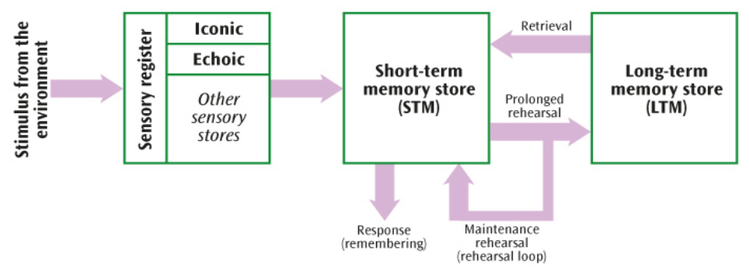
MEMORY
PAPER 1
Multi-Store Model:
States that there are three memory stores and each has a different encoding, capacity and duration. Information moves between these stores through either attention or rehearsal.
Sensory memory 🡪 Holds information from the senses for a short time and has a large capacity, Paying attention to information transfers it to the STM.
STM 🡪 Temporary memory store with a limited capacity of between five and nine items or chunks of information (7+/-2), lasting up to 30 seconds. Information is encoded acoustically.
If information is rehearsed for long enough it is transferred into LTM.
LTM 🡪 Encoding by meaning (semantically), this is a permanent memory store with an unlimited capacity and information can be stored up to a lifetime.
Evaluation:
Simple model 🡪 suggests we have one STM and one LTM (-)
Research support 🡪 Baddeley= STM=acoustic + LTM= semantic (+)
Research support comes from artificial materials (-)

Slide 3
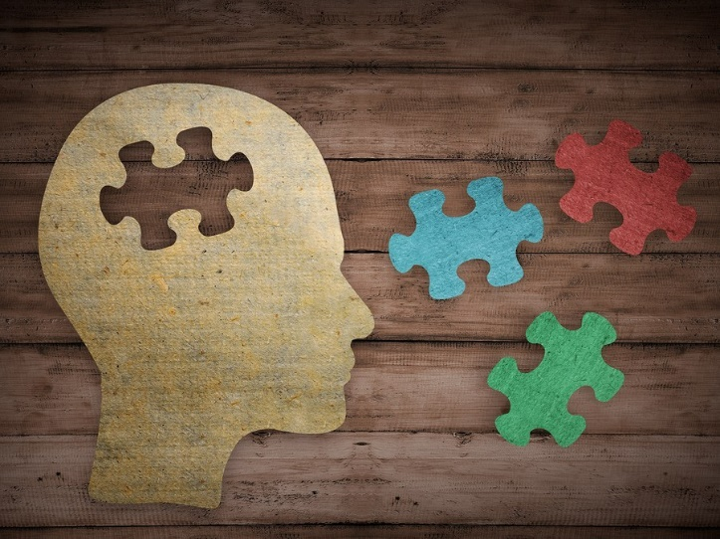
MEMORY
PAPER 1
Bartlett’s Theory of Reconstructive Memory:
Memory is an active process as demonstrated by the War of the Ghosts study. People remember the overall meaning of events and, when retrieving information, they rebuild the memory.
We do not have exact recall. Elements are missing and memories are not an accurate representation of what happened.
We record small pieces of information in long-term memory. During recall we recombine them to tell the whole story. Each time, the elements are combined slightly differently.
The way that information is stored and recalled is affected by social and cultural expectations.
We focus on the meaning of events and make an effort to understand the meaning to make sense of the parts of the story.
Evaluation:
Real-life application 🡪 explains problems with eyewitness testimony (+)
Not all memories are reconstructed (-)
Research does not use artificial word list but instead uses a story = reflects memory in our everyday lives (+)

Slide 4
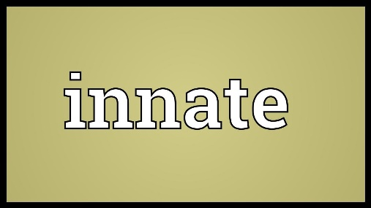
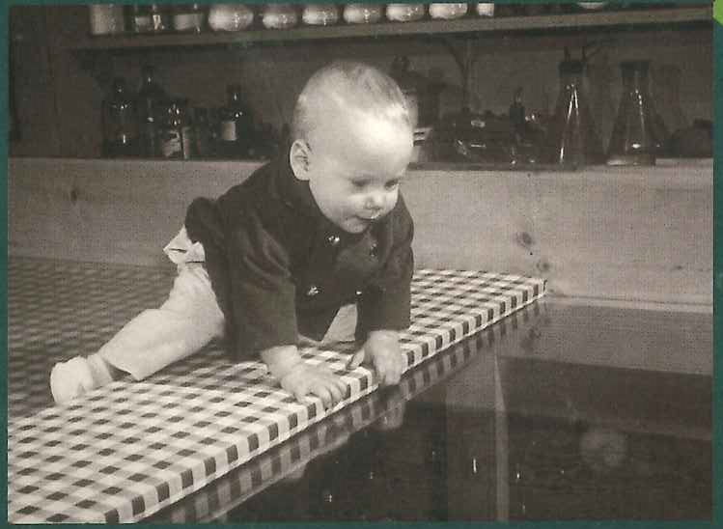
PAPER 1
PERCEPTION
Gibson’s Direct Theory of Perception:
Gibson’s direct theory of perception states that perception is an innate process. Therefore, the theory is based on the principles of nature as it believes we are born with our perceptual abilities. Gibson argues that our optic array provides us with sufficient information to make sense of the world and we do not need past experiences or expectations to fill in the gaps. Gibson’s direct theory of perception argues that we use monocular and binocular depth cues to understand depth and distance. Also, motion parallax helps us understand the speed of movement, objects closer in our visual field move faster than objects further away.
Evaluation:
Research support 🡪 very few infants would crawl off a ‘visual cliff’ (+)
Struggles to explain visual illusions (-)
Reductionist 🡪 only takes into account nature (-)

Slide 5
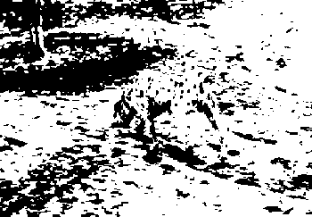
PERCEPTION
PAPER 1
Gregory’s Constructivist Theory of Perception:
Gregory’s constructivist theory of perception states that perception is learnt through experience and so is an explanation focusing on nurture. Gregory argues that we make inferences about sensory information using past experiences and expectations to make sense of the world around us. The brain uses sensory information that is available and then fills in the gaps. Perception is a process of construction. Our perception becomes more sophisticated as we grow and interact more with the world around us. Research shows that our cultural background and the way we are raised can be an important influence on the way we see things.
Evaluation:
Reductionist 🡪 only takes into account nature (-)
Research support 🡪 cultural differences affect how visual cues are interpreted (Hudson and Muller Lyer) (+)
Visual illusions = artificial (-)
Contradicting evidence 🡪 babies have some perceptual abilities at birth (‘visual cliff’) (-)

Slide 6
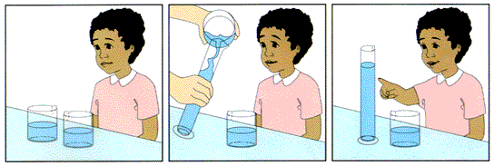
Piaget’s Theory of Cognitive Development:
Children’s brains develop in stages and at each stage different kinds of thinking occur.
As children develop they create mental representations of the world (schemas). A schema is a mental structure containing knowledge. They become more complex through assimilation and accommodation. Assimilation (add) = understand new experience by adding new information to existing schema. Accommodation (new) = new experience leads to forming a new schema.
DEVELOPMENT
PAPER 1
Piaget’s Stages of Cognitive Development:
Sensorimotor stage (0-2) – Focus of development is on relating what is seen/heard (sensory) with movement (motor). Object permanence: children over 8 months believe that an object that is not visible still exists.
Preoperational stage (2-7) – Children under age of 7 can’t think with consistent logic so are egocentric and lack conservation.
Concrete operational stage (7-11) – At 7 years, most children can conserve and show less egocentrism. Logical thinking can only be applied to physical items not objects or situations that cannot be seen.
Formal operational stage (11+) – Children can come to conclusions about problems presented in an abstract form.
Evaluation:
Sample bias-unrepresentative-middle-class children (-)
Real-world application- helped in the classroom from old–fashioned sitting down and listening to teacher to activity-based learning (+)
Underestimated children’s abilities – Hughes and Donaldson’s research show children conserve and reduce egocentrism at much younger age (-)

Slide 7
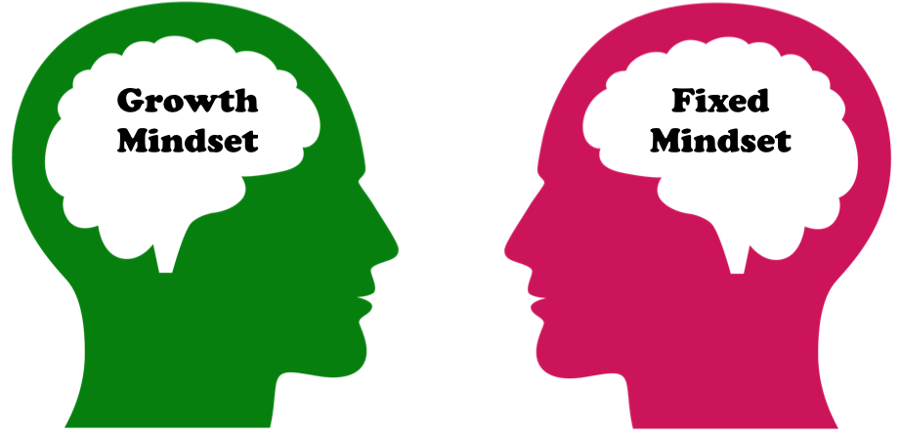
DEVELOPMENT
PAPER 1
Dweck’s Mindset Theory:
The difference between people who are successful and not successful is their mindset.
People with a fixed mindset believe that abilities are fixed in the genes. They think that putting in extra effort won’t help if someone is failing because success is all about innate talent. They are focused on performance goals and feel good when performing well.
People with a growth mindset think you can always improve yourself with effort. They enjoy a challenge and don’t focus on success. They focus on learning goals and feel good when working hard.
Fixed mindset 🡪 failure is due to lack of talent so not point trying harder.
Growth mindset 🡪 failure is an opportunity to learn more and put in more effort.
People are not simply one or the other but a mixture, o a continuum from fixed to growth. Where you are on the continuum depends on the situation.
Evaluation:
Research support🡪 those taught growth mindset had better grades than group taught about memory (+)
Rea-life application 🡪 can be used in everyday settings e.g. schools, business, sports, relationships etc (+)
Both mindsets involve praise (-)

Slide 8

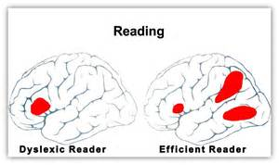

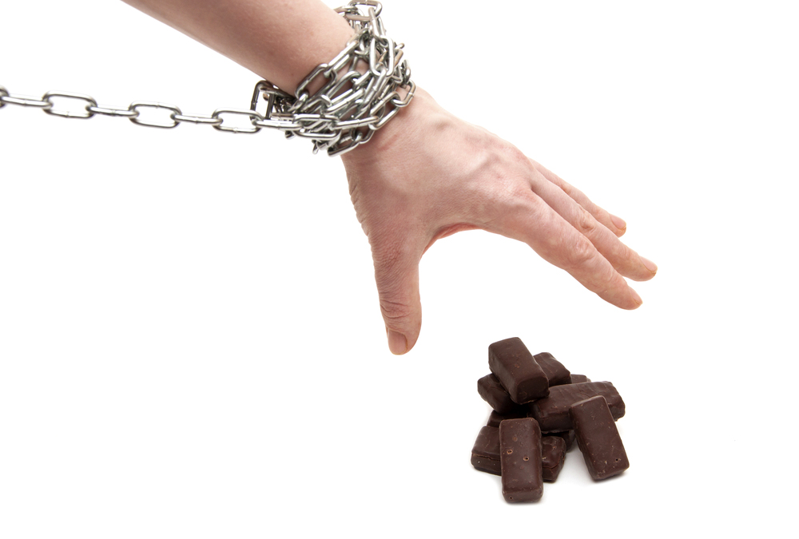
DEVELOPMENT
PAPER 1
Willingham’s Learning Theory:
Willingham criticises the theory of learning styles because of lack of scientific evidence.
He argues that we can improve learning by applying the results of scientific research in cognitive psychology and neuroscience.
Praising effort should be unexpected. Research found that if performance depends on praise, a person works to get the praise rather than to feel good.
Memory research has found that forgetting often occurs because of a lack of right cues. People should practice retrieving information from memory.
Self-control or self-regulation is being able to control your behaviour: your emotions, attention and cognitive processes. This has been linked to better school progress.
Brain waves in children and adults with dyslexia are different from those in people without dyslexia. If a specific pattern is associated with dyslexia they could receive help earlier, which will benefit progress.
Evaluation:
Uses scientific evidence 🡪objective investigations = greater validity (+)
Real-life application 🡪 relevance to education (+)
Dyslexia cannot be diagnosed by observing people’s brain waves (-)

Slide 9


SOCIAL INFLUENCE
PAPER 2
Milgram’s Agency Theory (Social Factors):
Explains obedience in terms of the power of others and social factors.
Agentic state: person follows orders with no sense of personal responsibility. Autonomous state: person makes their own free choices and feels responsible for their own actions.
The term ‘agentic shift’ is used to describe the change from autonomous to an agentic state. This shift occurs when a person sees someone else as a figure of authority.
Socieities have a hierarchy with some people having more authority than others. This hierarchy is agreed on by all members. The culture we live in socializes us to respect the social hierarchy.
Proximity 🡪 physically closer to authority figure = more obedience.
Evaluation:
Doesn’t explain all findings 🡪 in Milgram’s electric shock study, 35% did not go up to maximum shock (-)
Research support 🡪 students shown a film of Milgram’s study blamed the ‘experimenter’ rather than the ‘learner’ (+)
Gives an excuse for obedience ‘I was just following orders’ = dangerous as it excuses people from their actions (-)

Slide 10


SOCIAL INFLUENCE
PAPER 2
Adorno’s Authoritarian Personality (Dispositional Factors):
Explaining obedience in people’s personality.
Some people have an exaggerated respect for authority. They are more likely to obey orders and look down on people of inferior status. They have a rigid style of thinking (‘black and white’) and believe in stereotypes and don’t like change.
Originates from overly strict parenting and receiving only conditional love from parents. Child identifies with parents’ moral values.
The child also feels hostility towards parents and displaces this onto offers who are socially inferior in a process called scapegoating. You offload anger to something else, relieving anxiety and hostility.
Evaluation:
Correlational 🡪 cannot claim authoritarian personality causes greater obedience.
Individual differences 🡪 not everyone with strict parenting develops authoritarian personality.
Use of questionnaire 🡪 response bias
Cannot explain all cases of obedience --? Millions of Germans displayed highly obedient an prejudiced behaviour but didn’t have the same upbringing or same personality.

Slide 11
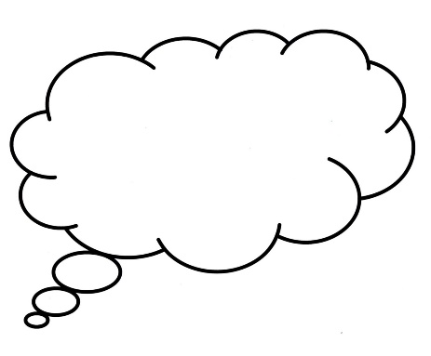
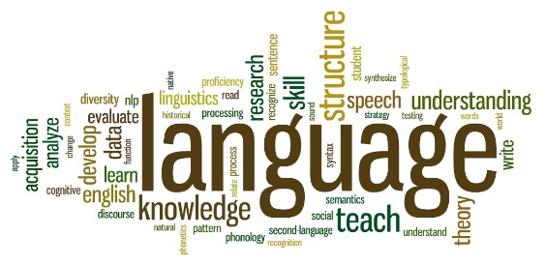

L,T&C
PAPER 2
Piaget’s Theory of Language and Thought:
Piaget’s theory of cognitive development concerns how our thinking develops. He proposed that we learn by developing schemas about the world.
Children develop language by matching the correct word to their knowledge. Thought and understanding come first, language develops after.
Children only understand when they have reached the correct stage of development and are ready. They can have language without understanding but will not be used effectively.
Sensorimotor stage: children speak towards the end of their first year. Preoperational stage: from 2 years they talk about things not present. Concrete operational stage: by 7 years children’s language becomes mature and logical as they question things and create their own ideas.
Thought comes first
Evaluation:
Supporting evidence 🡪 when children start talking they use two-word phrases (‘mommy sock’) which shows they can see how objects relate to each other (+)
Challenges 🡪 Sapir-Whorf hypothesis = language before thought (-)
Schemas cannot be scientifically tested (-)

Slide 12
The Sapir-Whorf Hypothesis:
Sapir and Whorf suggested that it is not possible to think about something you don’t have words for.
Language comes first and thought develops after. There are two versions of the hypothesis: one which believes words determine our thought (strong version) and one which says that words just influence thoughts (weak version).
Strong version = If there are no words for a though, object or idea then you can’t think about it. This is why it is difficult to translate ideas from one language to another.
Weak version = words help to ‘carve up’ the world. However, you can still imagine something with no words for it.
Weaker version preferred. If the words we have for a concept or idea are limited, our ability to notice or recall that idea will also be limited.
L,T&C
PAPER 2
Language comes first
Evaluation:
Differences between cultures exaggerated (-)
Having more words does not mean the words came first
Explains the link between language and intelligence. Restricted code in working-class children negatively effect on their ability to think (+)

Slide 13
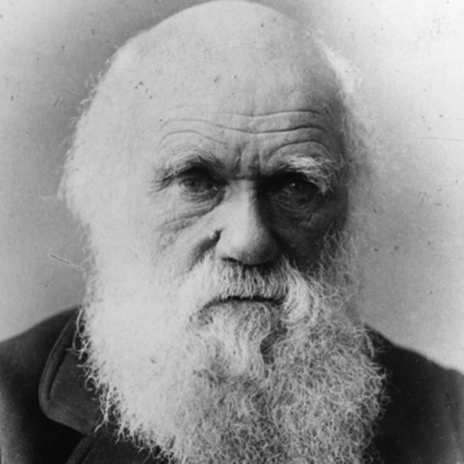
Darwin’s Evolutionary Theory:
Darwin proposed the theory of natural selection: The genes for any behaviour that improves an animal’s chances of survival and reproduction are more likely to be passed to the next generation.
Non-verbal behaviours that are beneficial (adaptive) are naturally selected. Baring teeth in a fight causes the attached animal to get scared and leave and therefore both animals in the fight are more likely to survive. This means the behaviour is adaptive – it helps protect survival.
Opening eyes wide indicates surprise because it evolved from animal behaviour – it would help animals under threat to see an escape route. This behaviour is passed down to humans and continues to express surprise.
Behaviours adaptive to our distant ancestors (e.g. wrinkling the nose and baring teeth) still show how we feel but may not serve the original adaptive purpose.
L,T&C
PAPER 2
Evaluation:
Research support 🡪 6 primary emotions universal (found in all people) (+)
Newborn studies 🡪 babies born with ability to smile/eye contact = innate (+)
Cannot explain cultural differences in non-verbal communication – personal space and gestures differs from one culture to another (-)

Slide 14
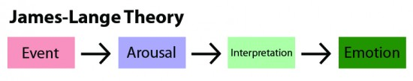
James-Lange Theory of Emotion:
Physiological arousal comes first and emotion after.
An event causes physiological arousal in the following way:
Hypothalamus arouses the sympathetic division of the ANS 🡪 adrenaline is released and creates physiological arousal (increased heart rate, etc = fight or flight response) 🡪 brain interprets the physiological activity 🡪 causes emotions, e.g. fear, excitement, love.
Seeing a bear activates the sympathetic division, muscles tense, heart pounds, these physiological changes interpreted as fear and person runs away.
If no physiological changes occur then emotions are not experienced. For example, if you stand in front of your class and your heart rate doesn’t increase, then you do not feel scared because there are no physiological changes.
BRAIN & NEUROPSYCHOLOGY
PAPER 2
Evaluation:
Challenged by Cannon-Bard 🡪 we experience some emotions (e.g. embarrassment) at the same time as physiological arousal and not one after the other (-)
Challenged by two-factor theory 🡪 we need arousal plus social cues to correctly label the emotion we are feeling (-)
Real-life examples e.g. phobias

Slide 15
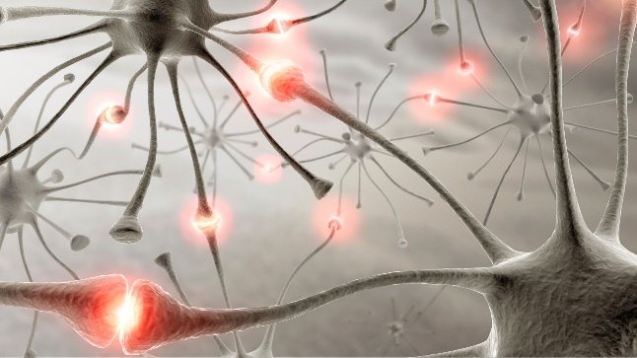
BRAIN & NEUROPSYCHOLOGY
Hebb’s Theory of Learning and Neuronal Growth:
Synaptic connects in the brain become stronger the more they are used. The brain has the ability to change and develop.
The brain changes structure and connections in response to new experiences or new learning. Any learning – at any change- can change the brain structure and connections.
Learning leaves a trace (engram). This can be made permanent if we practice and rehearse what we are learning.
Cell assembles are groups of neurons that fire together. They more they fire, the more the synaptic connections grow and strengthen. Neuronal growth occurs as the cell assemblies rewire to manage new learning.
PAPER 2
Evaluation:
Scientific 🡪 Objective basis for understanding behaviour (+)
Applied to education 🡪 rats in stimulating environments able to find their way through mazes = create stimulating environments for students to encourage learning (+)
Reductionist 🡪 reduces learning to a neuronal level, other non-biological factors e.g. Piaget, schemas + accommodation moves learning forward (-)

Slide 16
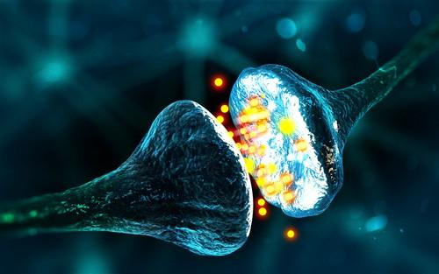
Biological Explanation of Depression:
Messages travel along a neuron electrically and are transmitted chemically across a synapse via neurotransmitters. Serotonin is a neurotransmitter, linked to several behaviours including depression and is responsible for mood.
High levels of serotonin in synaptic gap stimulate postsynaptic neuron, improving mood. Low levels mean less stimulation of postsynaptic neuron, resulting in low mood. Serotonin also affects memory, sleep and appetite. These are linked to the characteristics of depression,
Low serotonin can be due to nature (inheriting a poor ability to produce it), or nurture (your body turns tryptophan, found in proteins like cheese and fish, and in carbs like potatoes and pizza, into serotonin). If your diet is low in tryptophan then you won’t produce much serotonin.
PSYCHOLOGICAL PROBLEMS
PAPER 2
Evaluation:
Research support 🡪 research evidence = lower levels of serotonin in people with depression (+)
Cause or effect 🡪 Thinking sad thoughts and having difficult experiences could cause low serotonin levels (-)
Alternative explanations – reductionist 🡪some people with low serotonin don’t have depression = other factors needed to explain depression (-)

Slide 17
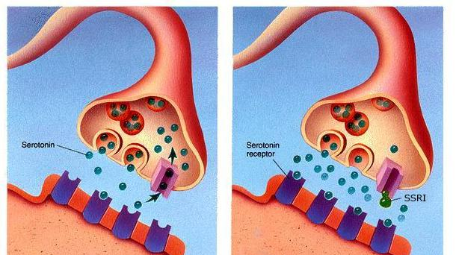
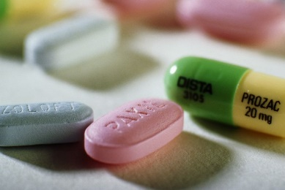
Biological Treatment of Depression:
Low levels of serotonin may cause depression, therefore increasing serotonin levels may remove the symptoms of depression. SSRIs are a type of antidepressant used to treat depression as they aim to increase the amount of serotonin in the synapse.
Serotonin is stored at the end of a presynaptic neuron in sacs called synaptic vesicles. The electrical signal travelling through the neuron causes the vesicles to release serotonin into the synaptic cleft.
Serotonin locks into the postsynaptic receptors and some is taken back into the presynaptic neuron.
SSRIs block this reuptake so when new serotonin is released it adds to the amount held in the synaptic cleft which increases the amount of serotonin and raises a person’s mood.
PSYCHOLOGICAL PROBLEMS
PAPER 2
Evaluation:
Side effects 🡪 e.g. nausea, insomnia, dizziness, eight loss or gain etc = people stop taking the drugs (-)
Effectiveness = placebo effect (-)
Reductionist 🡪 antidepressant medication targets serotonin so focuses on only one kind of factor (-)

Slide 18
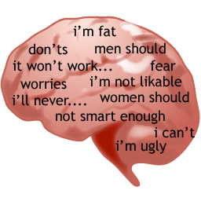

PSYCHOLOGICAL PROBLEMS
Psychological Explanation of Depression:
Depression is due to faulty thinking. People pay attention to the negative aspects of a situation and ignore the positives; their thinking is not logical (black and white thinking). This creates feelings of hopelessness and depression.
People use schemas to interpret the world, so if you have a negative self-schema this means that you are likely to interpret all information about you in a negative way.
Attribution = explaining causes of behaviour. When we observe someone else’s behaviour, we unconsciously think of explanations for their behaviour
Seligman says for a person with depression they have internal attribution (it’s my fault, I’m stupid), stable attribution (people will never like me again) and global attribution (everything I do goes wrong) which result in depression.
Seligman says this is due to nurture, and individuals have learned a negative attributional style. If a person has an unpleasant experience, the natural reaction is to try and escape. But if they can’t escape, the person learns to give up trying. This is called ‘learned helplessness’.
PAPER 2
Evaluation:
Research support 🡪 dogs learned to react to challenge by ‘giving up’ = learned helplessness (+)
Real-world application – treating depression through CBT (+)
Negative beliefs may realistic rather than depressing (-)

Slide 19

Psychological Treatment of Depression:
CBT focuses on what a client thinks.
Negative, irrational or faulty thinking causes depression because people who become depressed tend to think in all-or-nothing terms. This is called ‘catastrophising’ – making everything into a big failure.
Aim of therapist is to change this to rational thinking to reduce depression.
CBT aims to change behaviour indirectly through changing thinking.
Behaviour also changed directly, e.g. behavioural activation where a pleasant activity is planned each day, creates more positive emotions and mood.
‘Disputing’ is used to deal with the negative and irrational thoughts experienced by a depressed person (irrational thoughts are challenged).
More rational thinking leads to greater self-belief and self-liking.
Any negative emotions experienced are recorded in a ‘thought diary’, where the client also records the automatic negative thoughts created by these emotions. The client rates how much they believe in these thoughts
A rational response to the automatic thoughts is then recorded and rated.
PSYCHOLOGICAL PROBLEMS
PAPER 2
Evaluation:
Long lasting effectiveness 🡪 ‘tools’ learned help the client deal with future episodes of depression (+)
Time-consuming and effort required = drop out or fail to engage enough for it to work (-)
Holistic 🡪 focus on treating the whole person and deals with core symptoms of depression (feeling sad) (+)

Slide 20
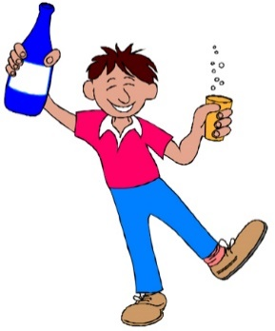

NAMED STUDY
PSYCHOLOGICAL PROBLEMS
Biological Explanation of Addiction:
Kaij’s Twin Study of Alcohol Abuse:
AIM: To see addiction is due to nature (hereditary factors) or nurture, using twins.
METHOD: Male twins from Sweden registered with the temperance board for alcohol problems were interviewed aswell as their relatives to collect information about drinking habits.
RESULTS: 61% of identical MZ and 39% of non-identical DZ twins both alcoholic.
CONCLUSION: Alcohol abuse related to genetic vulnerability. Not 100% genetic or MZ twins will all be the same as they same 100% of their genes. Not 100% environment or MZ and DZ twins will be the same as they share the same environment.
PAPER 2
Research suggest that addiction = highly inherited.
Multiple genes create a vulnerability
Diathesis-stress = genetic vulnerability (nature) is only expressed if a person’s life experiences (nurture) act as a trigger.
Evaluation:
Flawed study- only used drinkers who made a public display of their alcohol abuse.
Supported by later studies- MZ more likely to both be alcoholics than DZ twins
Misunderstanding genetic vulnerability

Slide 21
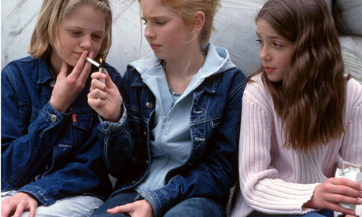
Psychological Explanation of Addiction:
Bandura states we learn how to behave and think by observing what others do. We imitate them especially if they are rewarded. We imitate those we identify with even more.
We don’t always know what behaviour is ‘right’ . We look to the behaviour of others to know what is ‘normal’ or acceptable. We learn from our peers’ behaviour and attitudes.
You identify with your social group (e.g. a group of students in your class). You want to be accepted by them, so behave like them. Adolescents in particular feel ‘pressure’ to conform to the social norms of their peer group.
Peers influence addictive behaviour because they provide opportunities. Peers may give direct instruction about what to do. Peer influence has also been found to be a strong factor in the use of drugs in teenage years. A study into peer influence found that individuals whose friends used drugs were more likely to start to use drugs.
PSYCHOLOGICAL PROBLEMS
PAPER 2
Evaluation:
Research support- positive correlation between peers and smoking (+)
Peer selection – individuals may actively select those who are like them rather than conforming to social norms (-)
Real-world application – social norms programmes have had more success than just teaching resistance skills (+)

Slide 22

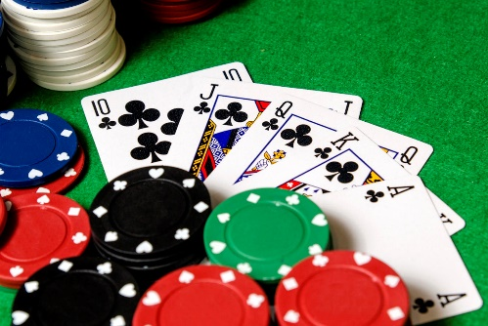
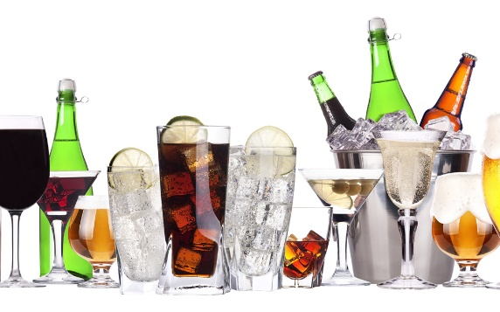
Treatment of Addiction- Aversion Therapy:
Based on classical conditioning. Addict learns to associate their addiction with something unpleasant, and therefore avoids the addictive substance.
Alcoholism: A drug like Antabuse is taken which causes vomiting is associated with alcohol. The addict takes Antabuse (UCS) which causes vomiting (UCR). Before vomiting, they have an alcoholic drink (NS). Alcohol becomes a learned/conditioned stimulus (CS) associated with vomiting (CR).
Gambling: An addicted gambler writes phrases related or unrelated to gambling on cards. A gambler reads out gambling-related words (NS) and gets and electric shock (UCS) each time, experiencing pain (UCR). Each phrase becomes a CS associated with pain (now a CR). Gambling related behaviours are then associated with pain.
Smoking: An addicted smoker rapidly smokes several cigarettes in a closed room. They associate the unpleasant feelings of disgust with smoking.
PAPER 2
PSYCHOLOGICAL PROBLEMS
Evaluation:
Poor long-term effectiveness- 9 year follow up = not effective (-)
Drop-out- many addicts drop out before the treatment is completed because of the unpleasant nature of the therapy (-)
Holistic- aversion therapy can be combined with CBT in a holistic way. Aversion therapy = immediate urge treated, CBT = change feelings/thinking (+)

Slide 23

Treatment for Addiction – Self-Management:
Require individuals to organise their treatment with no professional therapist guiding them.
A 12-step programme was developed by a group of alcoholics (Alcoholics Anonymous- AA). 12 principles to overcoming addiction.
Self-help groups, composed of others going through the same thing, are designed so the addicts can support each other.
One key element of the 12-step recovery programme is giving control to a higher power and letting go of your own will. Person accepts what they have done and members of the group and the higher power listen to the confession to accept the ‘sinner’.
Recovery is a lifelong process where the group supports each other. They can call other members in case of relapse.
PSYCHOLOGICAL PROBLEMS
PAPER 2
Evaluation:
Individual differences – demanding and requires high motivation so only effective for certain types of people (-)
Holistic – focuses on the whole person and not just their addictive behaviour (+)
Lack of clear evidence –weak evidence and problems with methodology (-)

